Slide 1

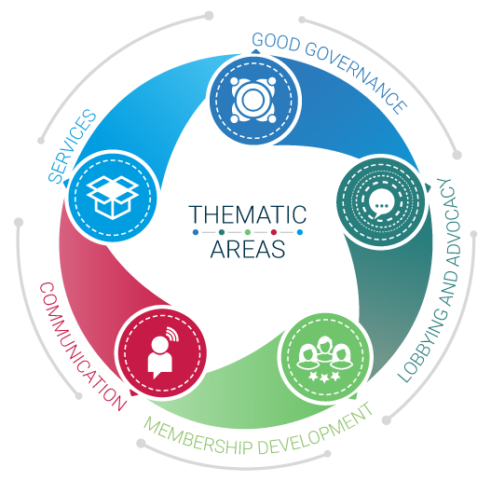

Employers’ Activities Programme
Effective Employers’ and Business Organizations
Lobbying and advocacy
Assessment of the business environment

Slide 2
Advocacy and Lobbying
Advocacy and Lobbying campaigns have one common goal:
To improve the business environment
But what its is? How to assess it? Is data available to me in order to do evidence-based advocacy and lobbying?

Slide 3

What is the Business Environment?
The Business Environment is the set of factors shaping the opportunities and incentives for firms to invest productively, create jobs and expand.
It consists in a complex of policy, legal, institutional conditions that govern business activities.
Political and macroeconomic stability
Access to credit
Level of infrastructure
Administrative system
Education system
Taxation
Open markets
Competition Law
Rule of Law
Labour legislation

Slide 4

Competitiveness
Improving the business environment contributes to improve competitiveness of the country!

Slide 5
The link BE / growth / poverty reduction
Prosperity gains &
Poverty reduction
Economic growth
Increase market share
Better current
account balance
and capital accumulation
Level of productivity
Competitiveness of my country
Good Business Environment
Notes:
EOs represent business interests to ensure that the economic actors can co-influence the political, social and economic environment, to make it conducive for WELFARE i.e. stability, growth, job creation, decent work, poverty alleviation.
EOs need to lobby for the achievement of each underlying condition to have having political, social and economic environments conducive to welfare:
Good business environment
Productivity gains
Competitiveness
Which in turn have a positive effect on Exports increase
Which in turn have a positive effect on Better account balance
Which in turn have a positive effect on stability and growth

Slide 6
But, what is competitiveness?
How the WEF defines competitiveness:
“The set of institutions, policies, and factors that determine the level of productivity of a country”
The level of productivity, in turn, sets the level of prosperity that can be earned by an economy

Slide 7




Competitiveness and enabling environment Indexes and Rankings

Slide 8
Global Competitiveness Report: key features
Compares 144 economies
160 Partner Institutions
Based on the work of Porter
Developed by Sala-i-Martín, Columbia and Artadi, Bocconi.
Uses 100 index
Is a weighted average of many different components.
Its components are grouped into 12 pillars

Slide 9
Global Competitiveness Index: data used
Statistics from international public organizations and private firms
Executive Opinion Survey
For more information: https://www.weforum.org/

Slide 10
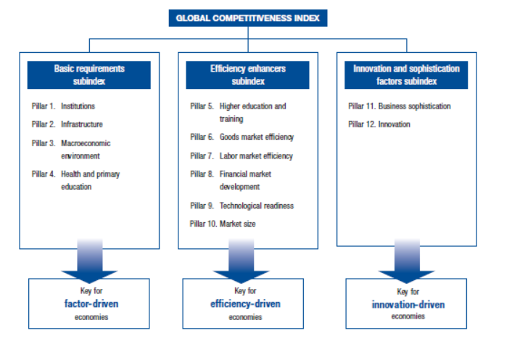

Slide 11
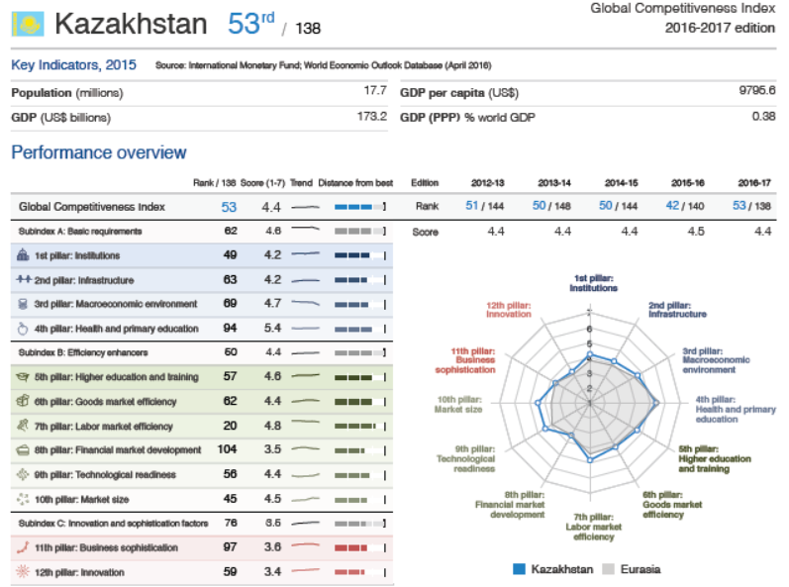

Slide 12
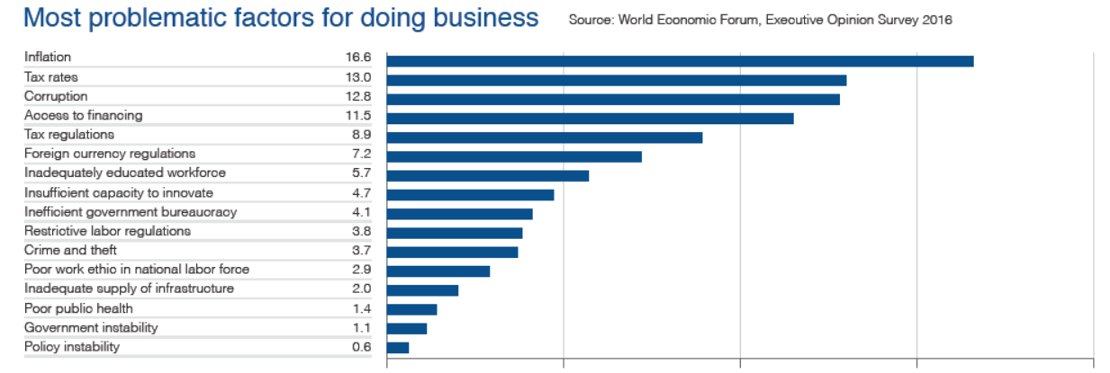
Do you agree with Kazakh business leaders? For discussion

Slide 13
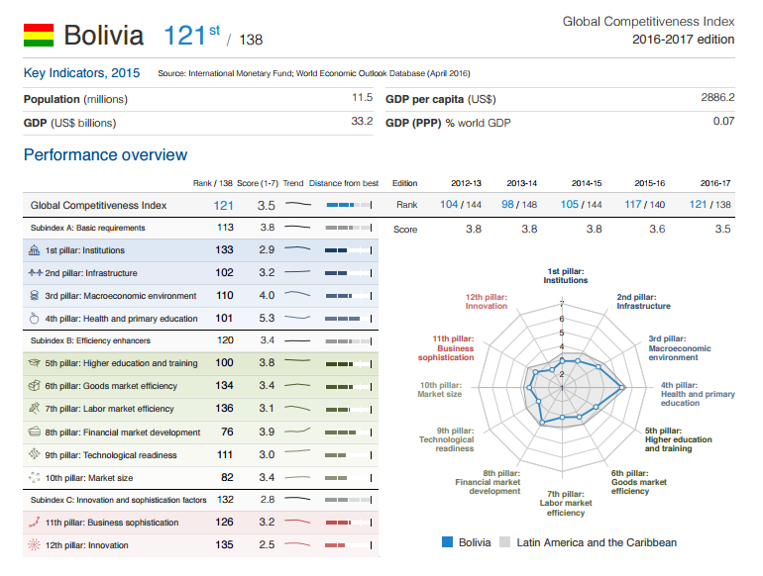

Slide 14
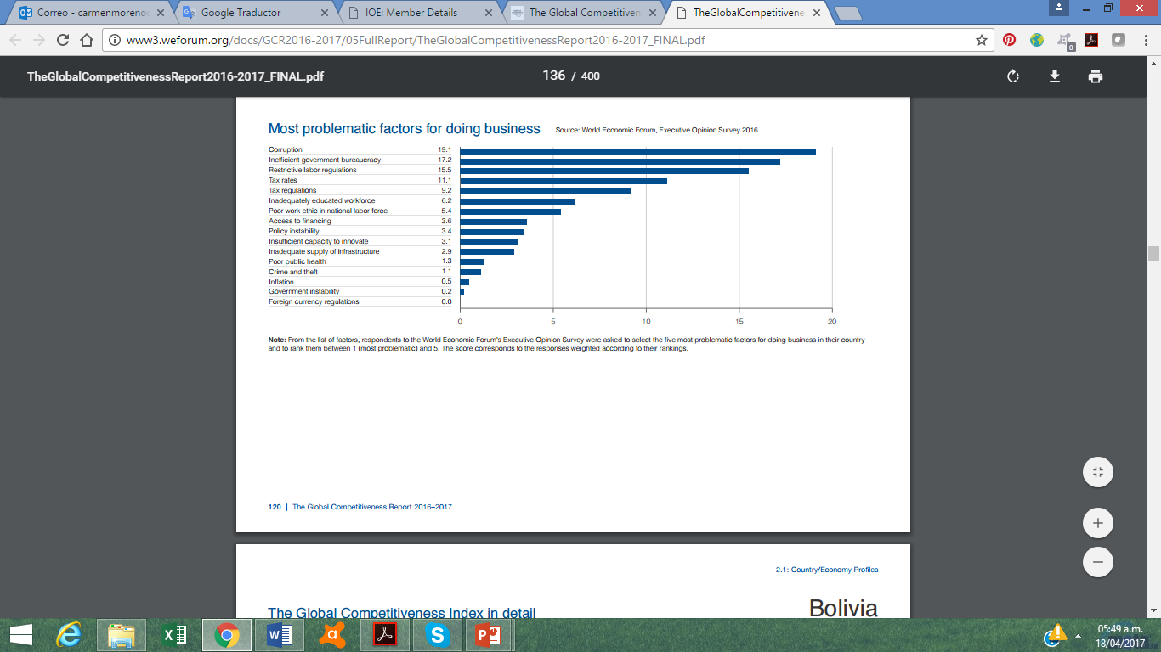
Do you agree with Bolivian business leaders? For discussion

Slide 15

World Bank: Ease of Doing Business
Measurement of “regulations that affect domestic small and medium-size enterprises, operating in the largest business city of an economy” (WB, 2015).
For more information: http://www.doingbusiness.org/

Slide 16
Ease of Doing Business Ranking: Key features
Since 2005
Compares 189 economies
Based on the work of Djankov and other World Bank economists
Is a weighted average of many different components.
10 sets of indicators

Slide 17
Ease of Doing Business Ranking

Slide 18
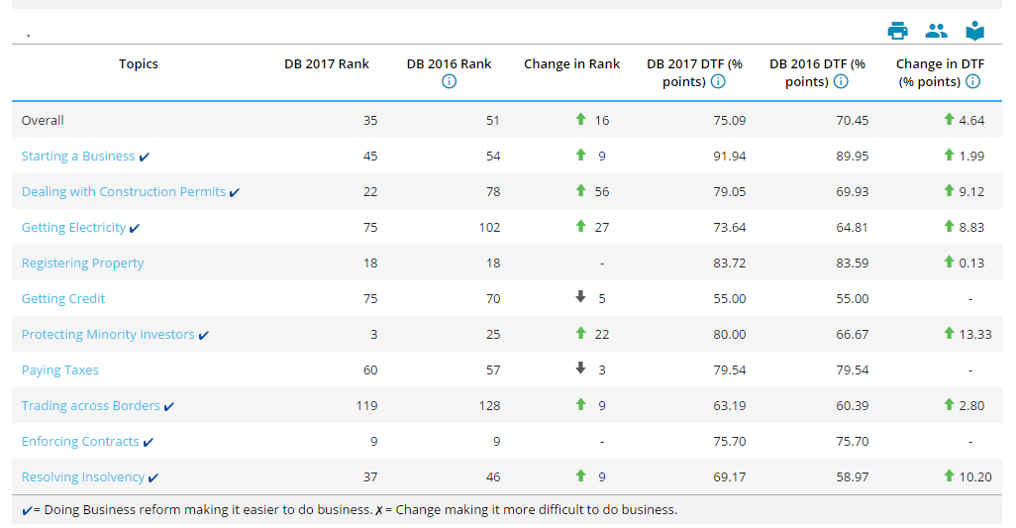
Ease of Doing Business Ranking in Kazakhstan

Slide 19
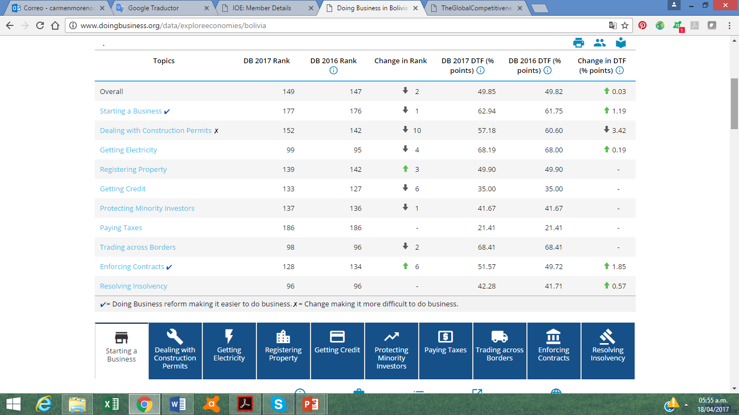
Ease of Doing Business Ranking in Bolivia

Slide 20

ILO Enabling environment for sustainable enterprises (EESE)
The ILO has devised its own assessment tool, Enabling Environment for Sustainable Enterprises (EESE), as a basis for providing evidence-based recommendations on how to improve the business-enabling environment. This tool focuses on the political, economic, social and environmental aspects of doing business.
For more information: www.ilo.org/eese and http://eese-toolkit.itcilo.org

Slide 21
We grouped the 17 pillars 4 areas and 5 “contexts”
MACROECONOMIC
▪ Macroeconomic policy
Trade & economic integration
▪ Financial access
ECONOMIC
ENVIRONMENTAL
▪ Environmental management
MICROECONOMIC
▪ Corporate culture
▪ Legal & regulatory
environment
▪ Fair competition
POLITICAL /
INSTITUTIONAL
ENVIRONMENTAL
▪ Infrastructure
▪ ICT
SOCIAL
POLITICAL / INSTITUTIONAL
▪ Peace & political stability
▪ Good governance
▪ Rule of law
▪ Human rights & international
labour standards
Social inclusion
Education and training
Social dialogue
Social protection
SOCIAL

Slide 22
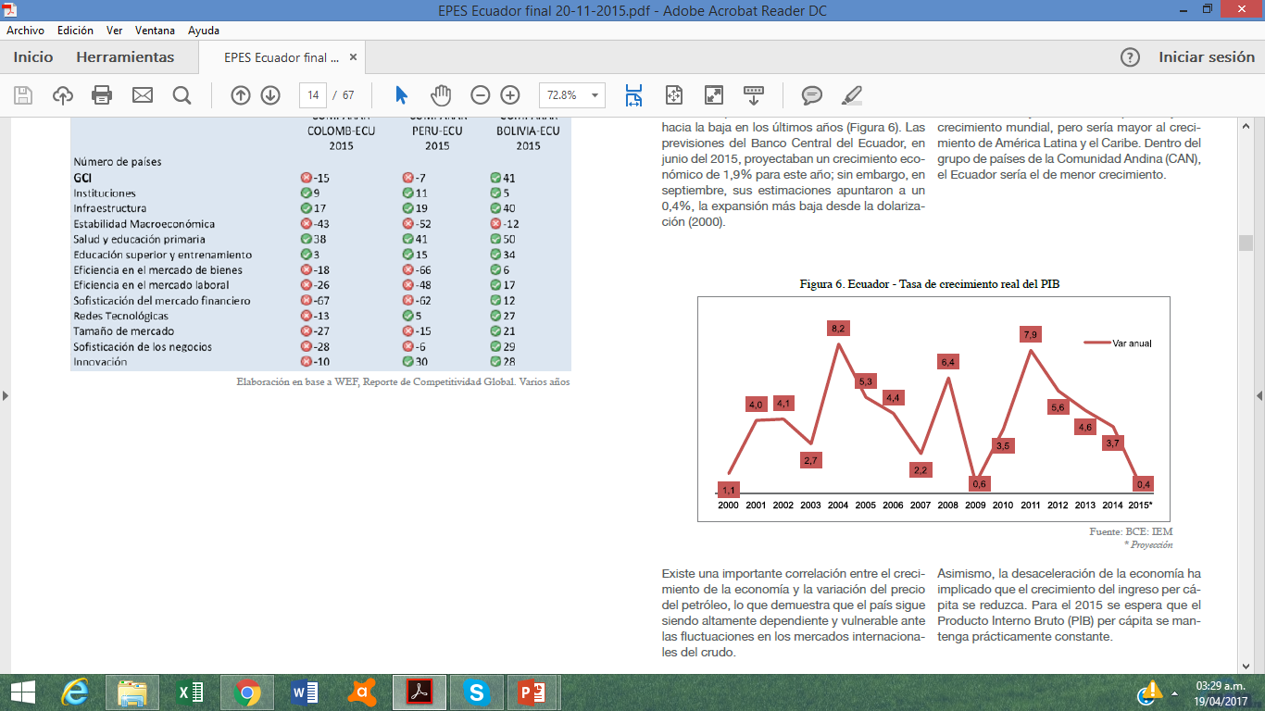
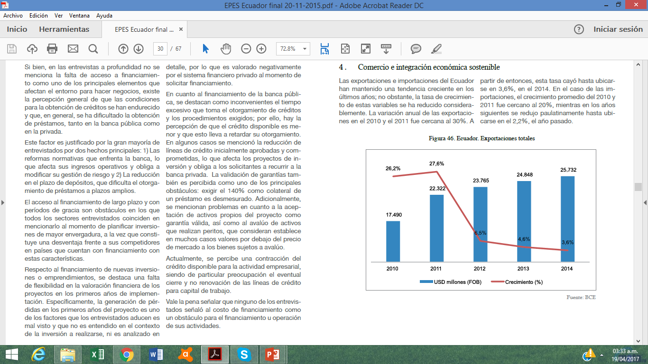
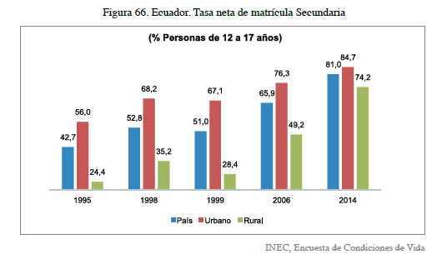
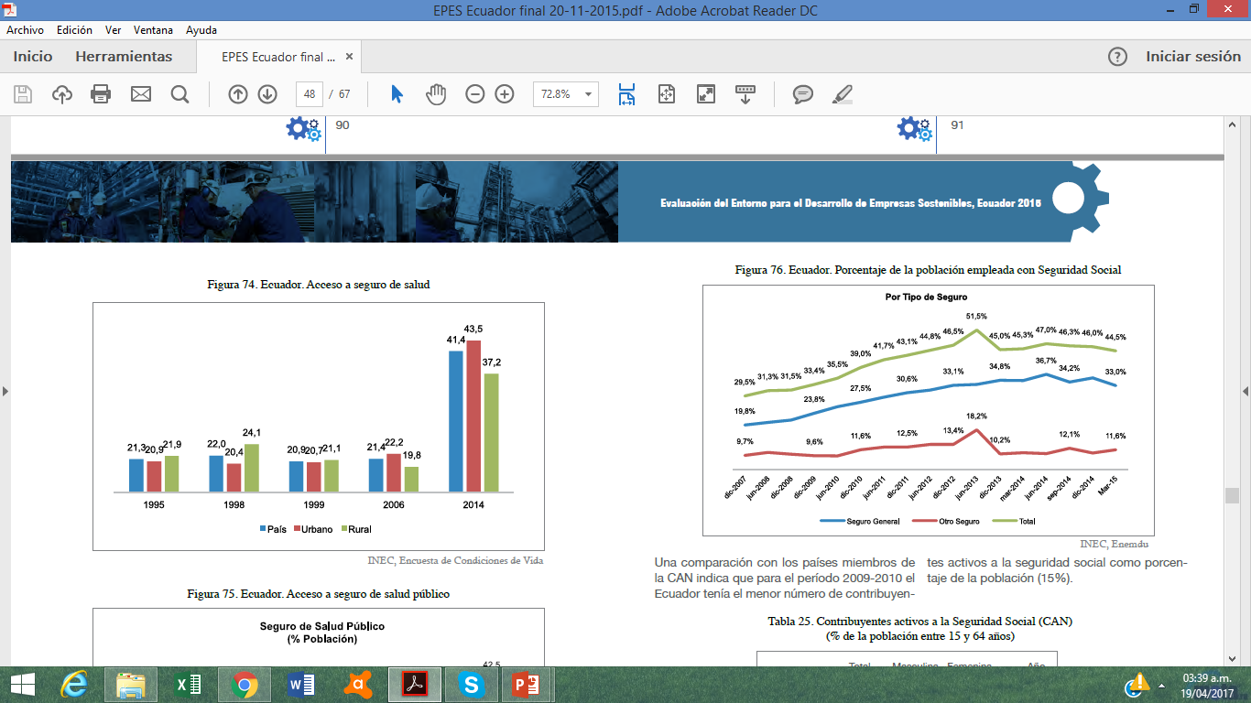
EESE Ecuador
Economic area:
Figure 6. Ecuador – Real GPD growth rate
Figure 46. Ecuador – Total exports
Social area:
Figure 66. Ecuador – Net rate of secondary inscription
Figure 74. Ecuador – Access to health insurance
Notes:
Economic area:
Real GDP growth rate: The growth rate of the Ecuadorian economy has shown an evident downward trend in recent years (Figure 6). There is an important correlation between the growth of the economy and the variation in the price of oil, which shows that the country remains highly dependent and vulnerable to fluctuations in international crude oil markets. Likewise, the slowdown of the economy has meant that per capita income growth is reduced.
Total exports: Ecuador's exports and imports have maintained an increasing trend in recent years; However, the growth rate of these variables has been considerably reduced. When analyzing exports by type of product, it is observed that exports of primary goods maintained a growing trend in recent years. In contrast, exports of processed goods suffered a significant reduction after 2013, which meant that exports of manufactured goods in 2014 are 21% lower than those of 2012.
Social area:
Secondary enrollment rate: The lack of economic resources is the main reason for not attending educational institutions. However, this reason has lost weight in recent years, falling from about 55% in 2004 to about 31% in 2013. Other high-profile reasons were: lack of interest (15.5%), Illness or disability (12.5%) and work (9.6%).
Access to health insurance.

Slide 23
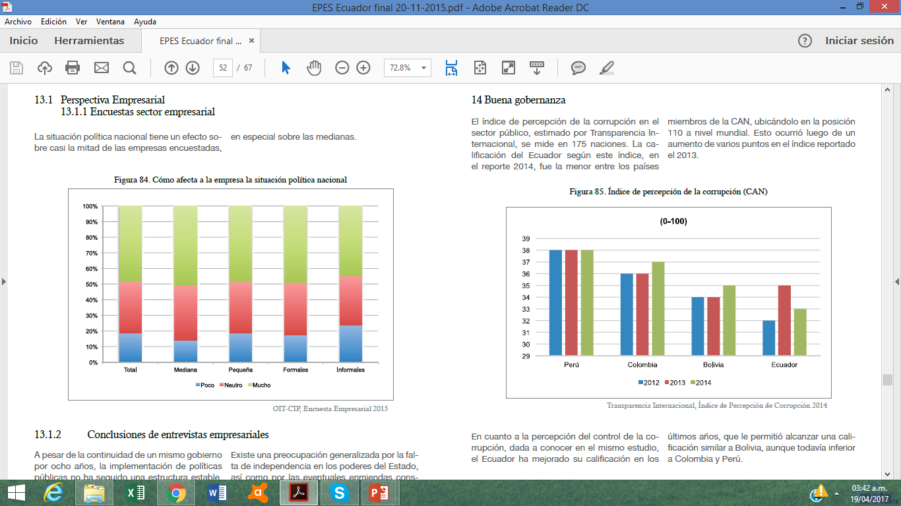
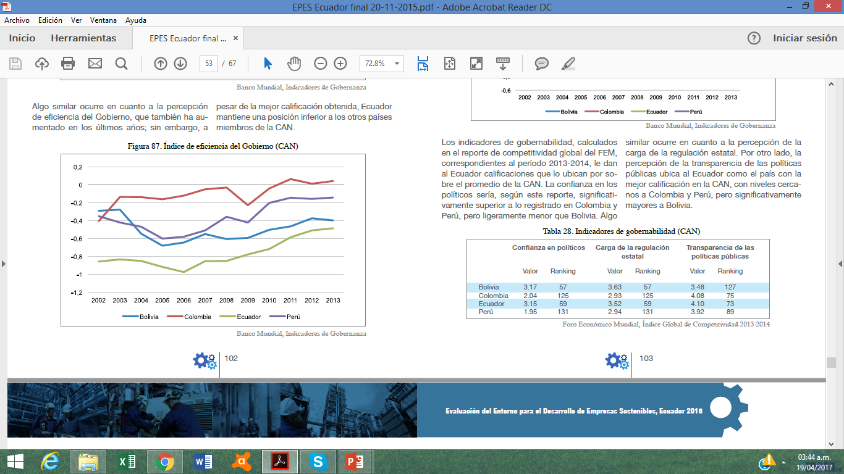
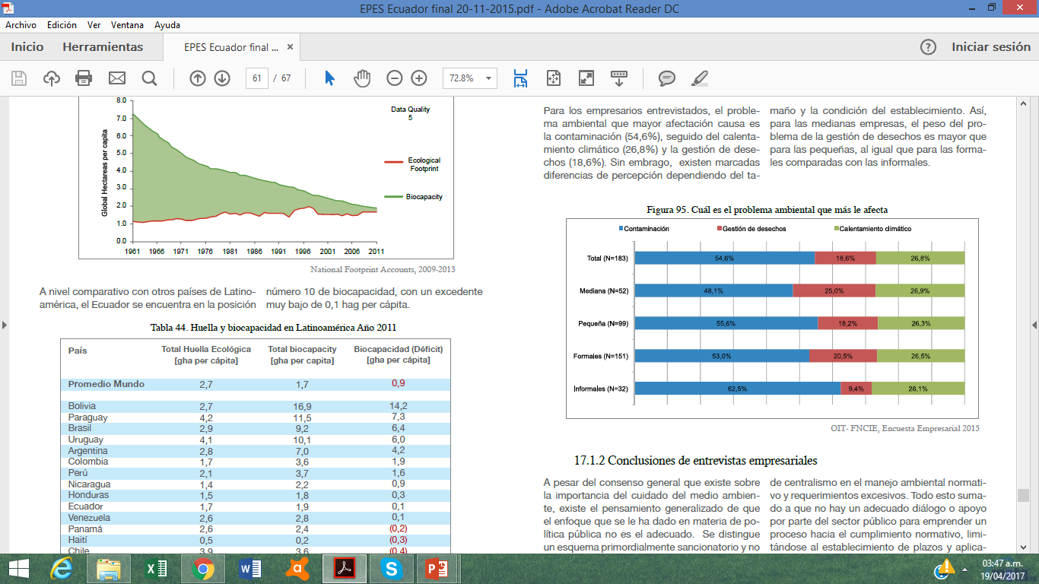
EESE Ecuador
Political area:
Figure 85. Corruption perception Index (CAN)
Figure 87. Government efficiency Index (CAN)
Environmental area:
Figure 95. Environmental problem that most affects you
Notes:
Political area:
Corruption Perceptions Index: The Corruption Perceptions Index in the public sector, estimated by Transparency International, is measured in 175 nations. Ecuador's rating according to this index, in the 2014 report, was the lowest among CAN member countries, placing it in position 110 in the world.
Government efficiency index: The perception of efficiency of the Government has increased in recent years. However, in spite of the best rating obtained, Ecuador maintains a lower position than the other member countries of the CAN.
Environmental area:
What is the environmental problem that most affects you?: For the entrepreneurs interviewed, the main environmental problem is pollution (54.6%), followed by climate warming (26.8%) and waste management ( 18.6%). However, there are marked differences in perception depending on the size and condition of the establishment. Thus, for midsize companies, the burden of the problem of waste management is greater than for small ones, as for formal ones compared with informal ones.

Slide 24
EESE-Data is designed within the Sustainable Enterprise Framework…
…close to 400 indicators per country in EESE-Data…
MACROECONOMIC
80+ indicators
05.01 GC - Strength of legal rights index
05. Getting Credit (GC)
05.02 GC - Depth of credit inform…
08. Trading Across Borders (TAB)
10. Resolving Insolvency (RI)
03.03 Inflation
08.08 Legal rights index (Borrowers…
03.04 Government debt
08.B. Trustworthiness and confidence
08.05 Venture capital availability
…
MICROECONOMIC
130+ indicators
07.06 PT - Total tax rate (% profit)
07.04 PT - Labour tax and contributions
07. Paying Taxes (PT)
07.03 PT - Profit tax
04. Registering Property (RP)
03. Getting Electricity (GE)
02. Dealing with Construction Permits
01. Starting a Business (SB)
06.05 Total tax rate
07.03 Hiring and firing practices
…
POLITICAL/INSTITUTIONAL
70+ indicators
06.01 PI - Extent of disclosure index
06. Protecting Investors (PI)
06.04 PI - Strength of investor prot...
09. Enforcing Contracts (EC)
06.02 PI - Extent of director liability…
06.03 PI - Ease of shareholder suits…
01.21 Strength of investor protection
07.10 Female participation in labour…
01.05 Irregular payments and bribes
01.12 Transparency of government…
…
ENVIRONMENTAL
15 indicators
EV - Climate and Energy EV - Water Resources Wastewater Treatment EH - Health Impacts Access to Sanitation
EH -Water and Sanitation
Access to Drinking Water
Environmental Health (EH)
Household Air Quality
Ecosystem Vitality (EV)
…
SOCIAL
70+ indicators
05.02 Tertiary education enrolment…
05.A. Quantity of education
05. Higher education and training
05.04 Quality of maths & science edu…
04.08 Life expectancy
04.06 HIV prevalence
04.09 Quality of primary education
04.07 Infant mortality
05.01 Secondary educ. enrolment rate
05.B. Quality of education
…
GENERAL
9 indicators
Ease of Doing Business (DB) Environmental Performance Index (EPI) Global Competitiveness Index (GCI)
I. GCI - Basic requirements
II. GCI - Efficiency Enhancers
III. GCI - Innovation & sophistication…
Global Enabling Trade Index (ETI)
Human Development Index (HDI)
Networked Readiness Index (NRI)
http://metaleph.com/eese-data/

Slide 25

We are a solid and reliable partner in the delivery of training for
Business Member Organizations and we look forward to assist you
in the implementation of your training needs
For further information, please contact:
Programme for Employers’ Activities
^{E-mail: actempturin@itcilo.org}
^{Phone: +39 011 693 6590}
^{http://lempnet.itcilo.org}

