Slide 1
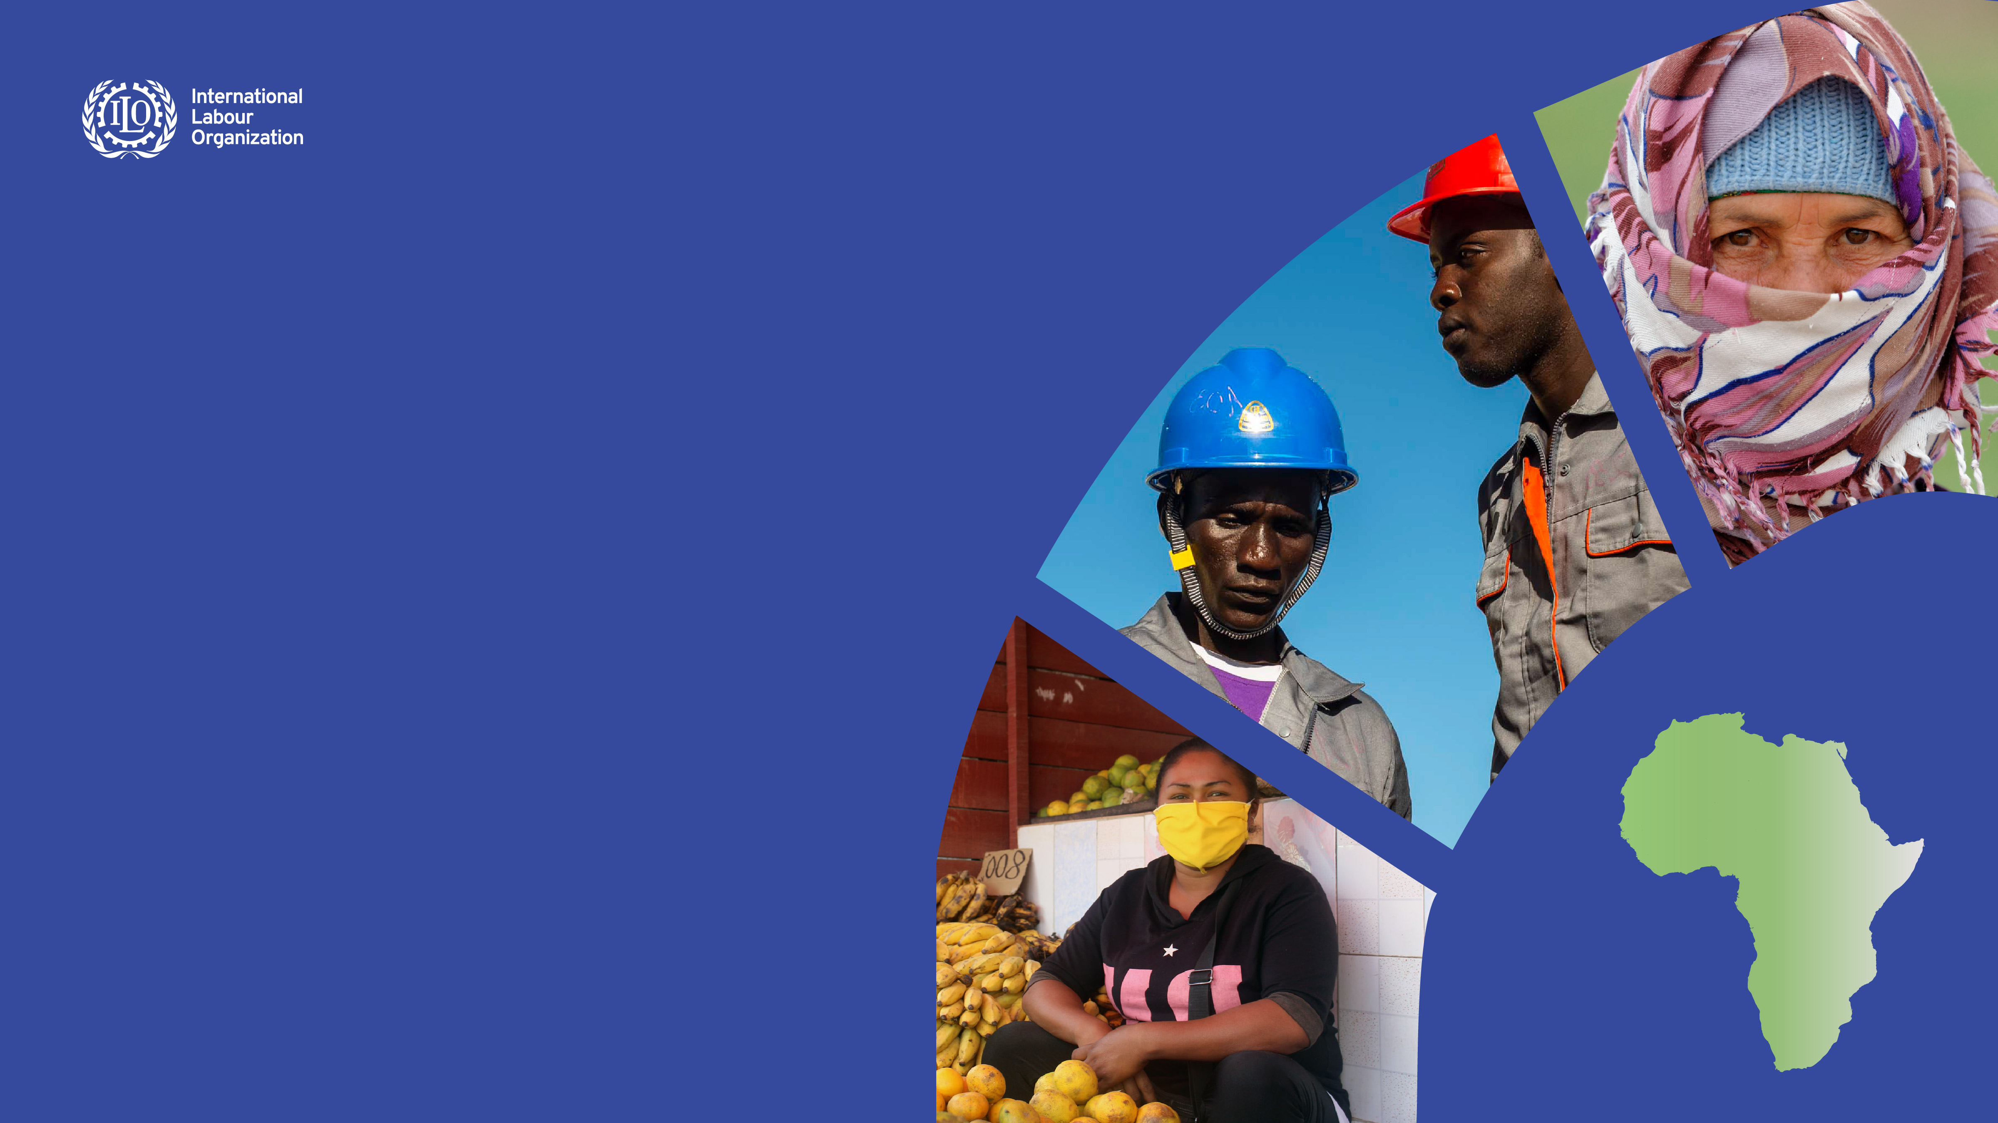
Africa Regional Social
Protection Strategy,
2021-2025
Towards 40% – a social protection coverage acceleration framework to achieve the SDGs
Cynthia Samuel-Olonjuwon,
Assistant Director General - Regional Director for Africa
November 2021

Slide 2
Contents
1. Problem analysis and Justification
1.1. Social protection: a human right and a social and economic necessity
1.2. The African context
1.3. Root causes of social protection coverage deficits in Africa
2. Strategy
2.1. Recent global and regional developments
2.2. Principle and enabling environment for the extension of social protection
2.3. Strategic action areas
3. ILO’s roles

Slide 3
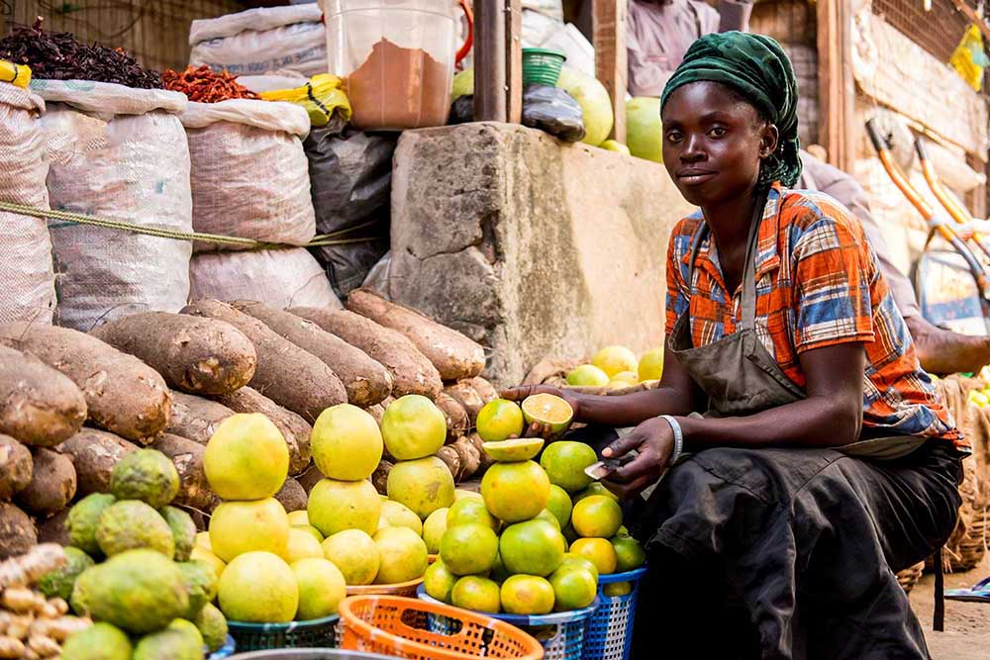
Problem Analysis and Justification

Slide 4
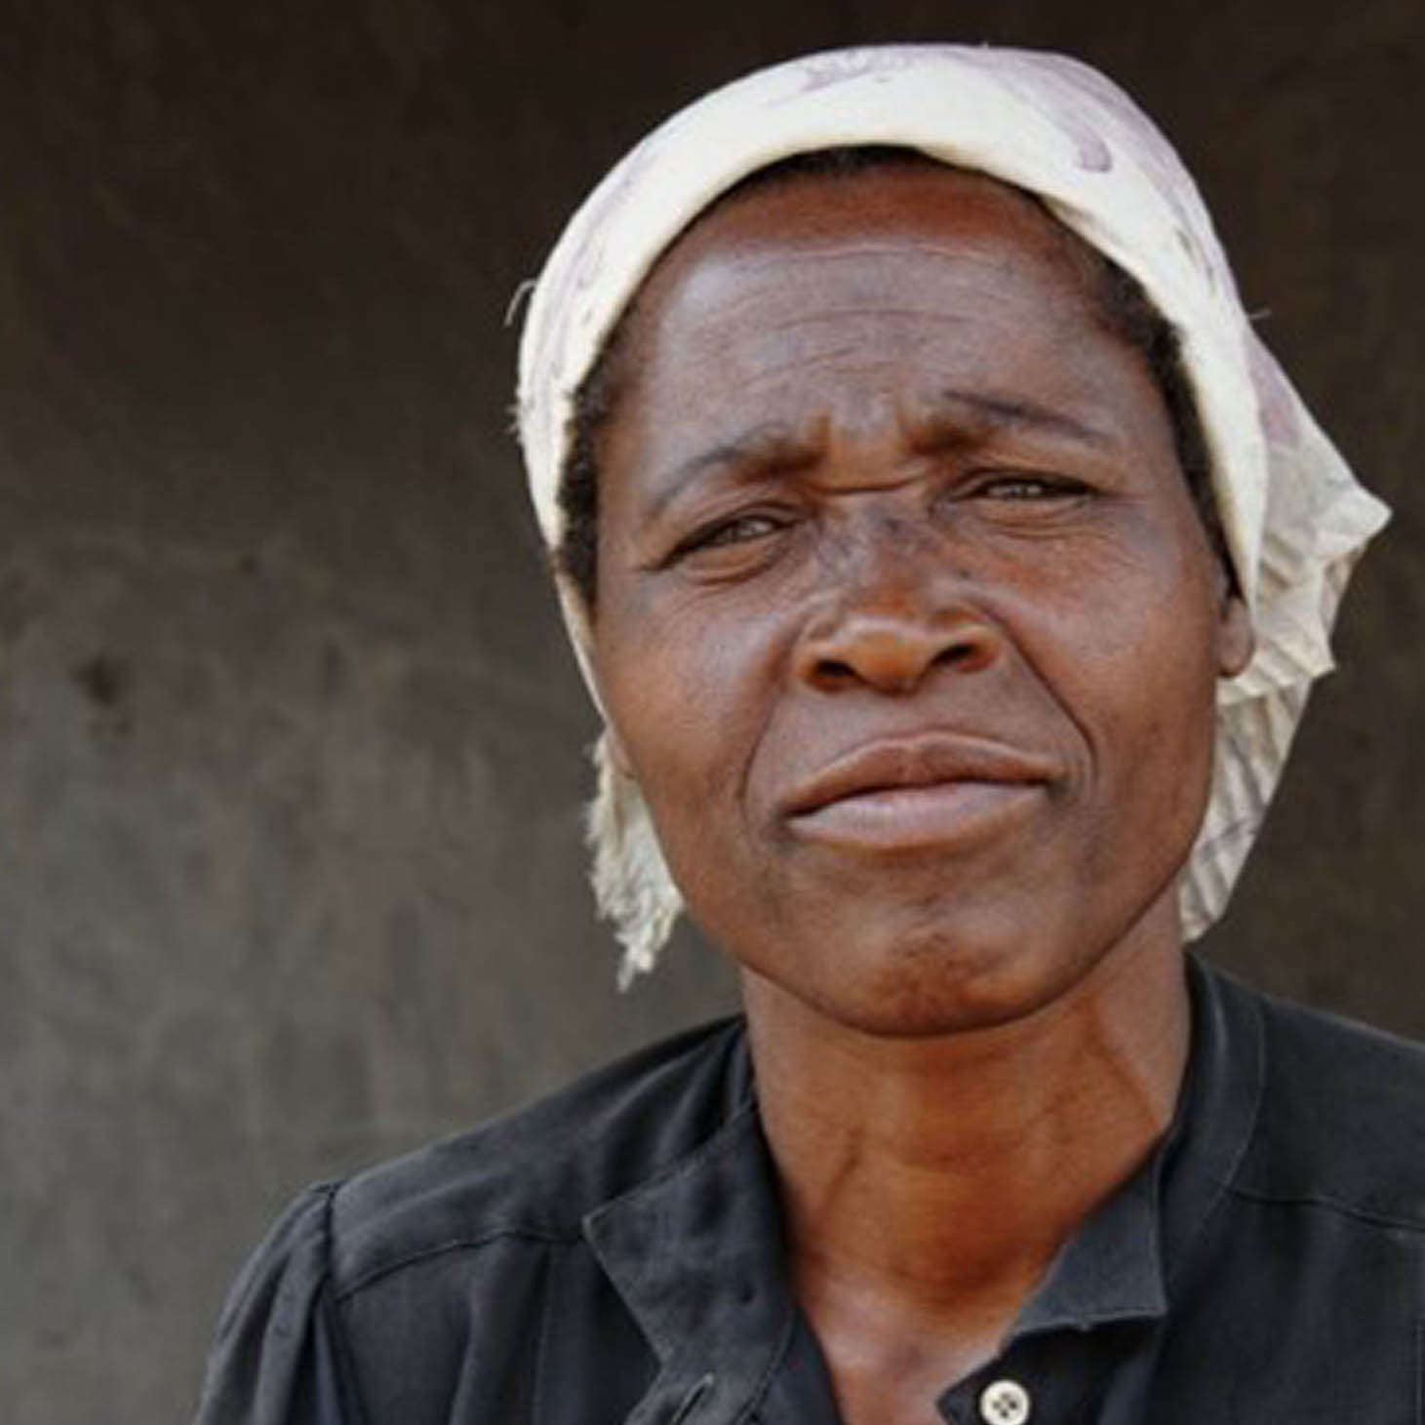
Social protection is a human right
Article 22: "Everyone, as a member of society, has the
right to social security”.
Article 25: “Everyone has the right to a standard of living adequate for the health and well-being of himself and of his family, (…) and the right to security in the event of unemployment, sickness, disability, widowhood, old age or other lack of livelihood in circumstances beyond his control.”
    Universal declaration of human rights, 1948, article 22 and 25

Slide 5
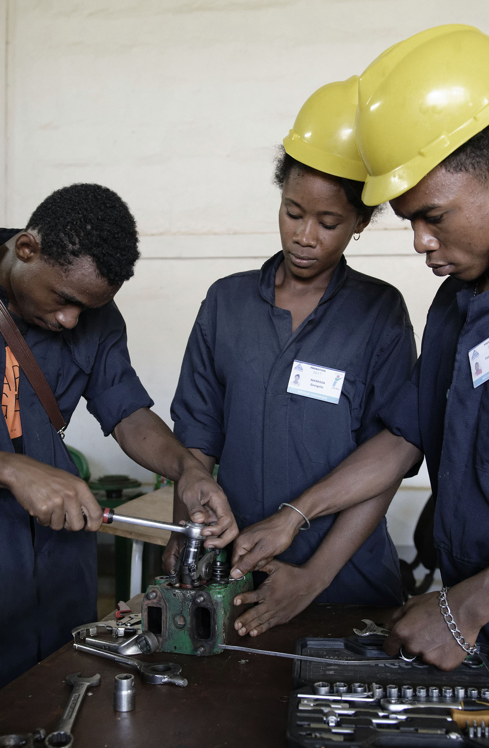
Social protection contributes to inclusive growth
Social protection promotes
    Income security and Poverty reduction
    Crisis recovery
    Productivity and employability
    Higher household consumption and domestic demand
    Social and political stability
    Structural transformations of the economy
    It is not a cost but an investment with high economic and social returns

Slide 6
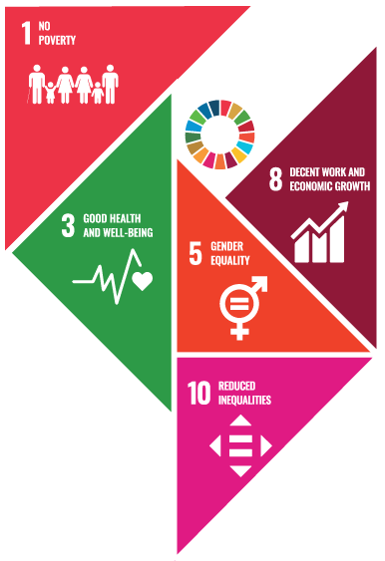
Social protection & Agenda 2030
Social protection contributes to five SDG targets
    SDG 1.3 – Social protection systems including floors
    SDG 3.8 – Achieve universal health coverage
    SDG 5.4 – Recognize and value unpaid care and domestic work through (…) social protection
    SDG 8.5 – Decent work for all women and men
    SDG 10.4 – Social protection policies to reduce inequalities

Slide 7





Social protection, a priority
in the regional Agenda
    Abidjan Declaration (December, 2019)
    ILO Centenary Declaration for the Future
    of Work (June, 2019)
    AU
    Agenda 2063
    Yaoundé
    Tripartite
    Declaration on
    the implementation
    of the Social Protection Floor (2011)
    AUC’s Ouagadougou
    + 10 Declaration
    and Plan of Action on Employment, Poverty Eradication and Inclusive Development
    (2015)

Slide 8
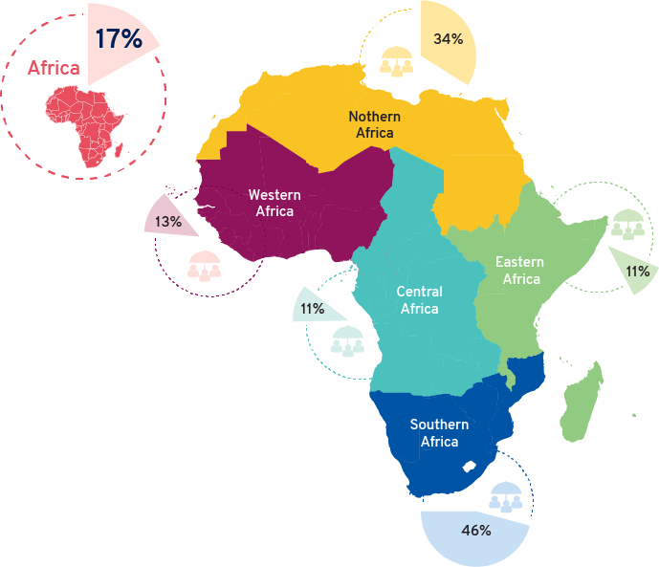
Low social protection coverage
in Africa and disparities across
sub-regions
The COVID-19 pandemic has exposed deep-seated inequalities and significant gaps in social protection coverage, comprehensiveness and adequacy
across all countries
Population receiving
at least one social
protection cash benefit
(SDG 1.3.1, WSPR)

Slide 9

Root causes of social protection coverage deficits
Need for a rights-based
approach
Weak governance and
administration
Underfunding of social
protection system
Absence of policy and
institutional coordination
Inequities affecting workers in the informal economy, migrants, refugees and other minority groups

Slide 10
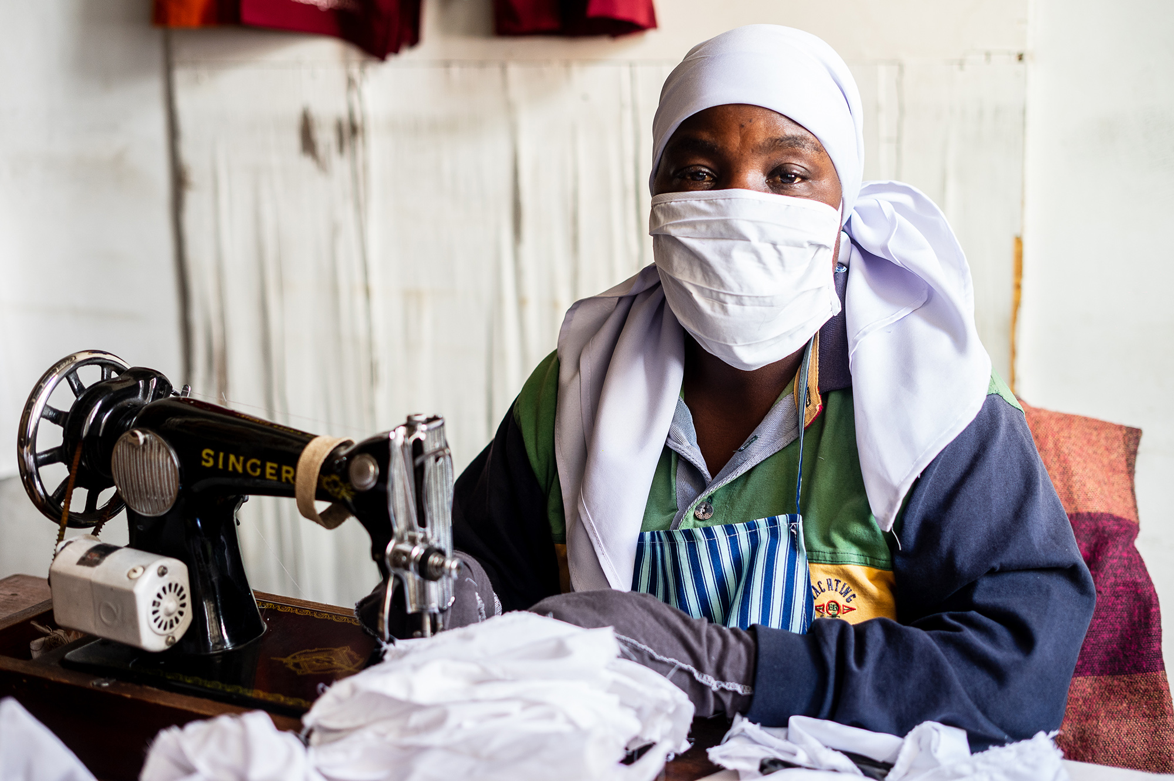
Africa Regional Social Protection Strategy, 2021 - 2025
Towards 40 % – a social protection coverage acceleration framework to achieve the SDGs

Slide 11
The strategy is built on recent developments in
social protection both at the global and regional levels
    Ministers of Labour Forum on COVID-19 response conveyed by the African Union Commission (AUC) in April 2020 and the ILO regional virtual meeting on COVID-19 crisis in Africa – building back better, held in July 2020.
    Conclusions from the Regional Dialogue for Accelerating
    Social Protection and Sustainable Financing in Africa organized by ILO in April 2021, in close collaboration with African Union Commission, and UNDP.
    Resolution concerning the second recurrent discussion
    on social protection adopted by the International Labour Conference in June 2021 which contains a framework for action towards universal adequate, comprehensive and sustainable social protection systems that are adapted to the developments in the world of work.
    UN SG’ Common Agenda Report especially the renewed social contract between Governments and their people and within societies, that includes a new era of universal social protection (September 2021).
    UN SG’ call for a Global Accelerator for Jobs and Social Protection led by the ILO, to create a new era of universal social protection, green and job-rich growth, and put the world back on track to reach
    SDG 1, SDG 8, and related goals (September 2021).

Slide 12
Principles
    Rights-based approach based on entitlements
    enshrined on national law;
    Diversity of methods and approaches and
    progressive realization;
    Universality of protection based on social solidarity;
    Adequacy and predictability of benefits; protection
    of rights and dignity of beneficiaries;
    Non-discrimination, gender equality and responsiveness to special needs;
    Financial, fiscal and economic sustainability;
    Transparency, accountability and sound financial management and administration; and
    Tripartite participation and consultation with representatives of persons concerned

Slide 13

Enabling environnent for the extension of social protection in Africa
A systemic approach
Social dialogue
Sound governance
Shock-responsive
Rights-based approach
Investment in data availability

Slide 14

Action area 1: Enhance coverage and adequacy through strong social protection strategies, legal framework and programmes
  STRATEGIC ACTION AREAS
Extend social insurance to workers in the informal and rural economies
Designing and implementing effective and sustainable social assistance programmes
  Recommendation 1
  Recommendation 2
  Extend social protection through the extension of social insurance coverage
  to previously unprotected categories of workers
  Strengthen the adequacy and scope
  of existing social assistance programmes.
  Recommendation 3
  Promote a systemic approach
  to safety nets programmes.

Slide 15
Action area 1: Enhance coverage and adequacy through strong social protection strategies, legal framework and programmes
  STRATEGIC ACTION AREAS
Achieving universal health coverage (UHC)
  Recommendation 4
  Recommendation 5
  Invest in the health sector.
  Support health protection financing from a combination of sources to allow the reduction or, where possible, elimination of co-payments.

Slide 16

Action area 2 : Close financing gaps by ensuring and sustainable financing
  STRATEGIC ACTION AREAS
  Recommendation 6
  Create more fiscal space for social protection by raising domestic revenues and improving effectiveness of existing fiscal envelope, at country level.
  Recommendation 7
  Support national social dialogue with the Government, employers and workers, civil society, UN agencies and other development partners in order to generate the political will to exploit all possible fiscal space options in the country and adopt an optimal combination of public policies on social protection.
Advancing social justice, promoting decent work

Slide 17

Action area 3 : Develop strategic partnerships
  STRATEGIC ACTION AREAS
  Recommendation 8
  Support coordination between organizations and
  other stakeholders in the area of social protection
  at the regional, sub-regional and national levels.

Slide 18
ILO ROLES
    The provision of “in country” support to
    develop national social protection systems
    following a three-step approach: (i) Assessment Based National Dialogue (ABND); (ii) Designing
    and reforming schemes and (iii) Improving operations
    The provision of “cross- country” policy
    and technical advice to respond to demand
    on specific thematic areas
    The development of knowledge and its dissemination (guides, tools, country briefs, trainings…)
    The development of strategic partnerships for success (with the UN, with the workers, with the business and a number of development partners).
    Promotion of ratification and application
    of ILO Standards

Slide 19

Thank you

