Slide 1
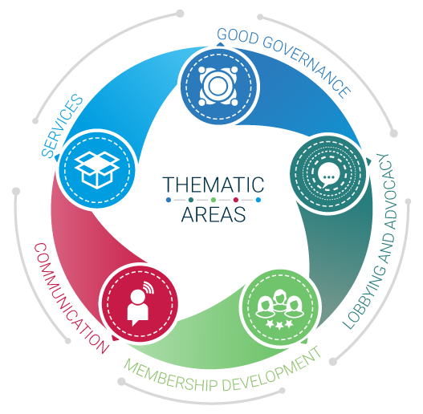
Employers’ Activities Programme Effective Employers’ and Business Organizations
Membership strategy

Slide 2
Membership Strategies
Tailor-made Guide on Membership strategies for EBMOs - Employers and Business Member Organizations
Final version to be published end 2018
Draft available on http://lempnet.itcilo.org

Slide 3
Importance of Membership
Employers and Business Member Organizations (EBMOs) are MEMBERSHIP Organizations
EBMOs exist to represent their members’ interests.
They do so in an independent way,
Members are free to join.
[ILO Convention No 87 on Freedom of Association]

Slide 4
Importance of Membership
In other words:
Without members, there is no EBMO!
EBMOs need to attract new members and retain existing ones
They need to add value to companies and association members on an on-going basis to ensure their sustainability (not just when figures get low!!)

Slide 5
The issues around membership
Further growth and influence
More resources
Virtuous Circle
Increasing membership
High representativeness
High quality services
More resources
High membership

Slide 6
The issues around membership
Membership low
Limited resources
Limited services
Low influence
More limited membership
Lower resources
Vicious Circle
More limited services

Slide 7
Membership strategies
Membership strategies are essential to EBMOs.
Membership strategies exist to ensure two things:
Without resources nor influence, EBMOs cannot exist
Revenue – resources
Representativeness - influence

Slide 8
Membership strategies
Even if Membership Strategies are unique to each EBMO, all organizations need to:
Identify what is being offered to members (in other terms: define the EBMO’s value proposition),
Know the current membership situation,
Maximize on membership cycle.

Slide 9
1. Define the Value Proposition
Relevance
Why and How does the EBMO solve your problem?
Quantified Value
What specific benefits does the EBMO bring?
Unique differentiation
Why can you get the benefits only through this EBMO?

Slide 10
1. Define the Value Proposition
The EBMO’s value proposition is
A marketing tool,
Easily available and understandable,
Very concrete.
Remember: belonging to a “Club” of peers can be a powerful attraction factor for membership. It is important to recognize it and use it for recruitment and retention (continued engagement).

Slide 11
2. Know the situation
At all times, it is essential to have a good understanding of
The current membership levels,
The reasons explaining the data.
Formulating Key Performing Indicators (KPIs) on Membership;
Having a system to record interactions with members and
Collecting both qualitative and quantitative data
are a MUST for professional EBMOs.

Slide 12
2. Know the situation
Remember: what gets measured, gets done!
EBMOs need to set Key performance indicators (KPI) for their membership strategies. Examples are:
Representativeness
Intensity
% Members using services
Relevance
Recruitment rate - Retention rate – average loyalty
Number of members per sector / size
N° of employed workers by members / Total n° of employed
Turnover achieved by members /Total GDP region or district
N° members, % Members paying subscription fees

Slide 13
2. Know the situation
Recording interactions with members is key – what happens in many cases is:
Data on members listed in Excel file: mostly only names and addresses
Different sources where information about members is stored
Limited possibility for analysis and reporting
Static : no linkages can be discovered
Labour intensive to update (often not done regularly)

Slide 14
2. Know the situation
Using a CRM (Customer Relation Management) Software will help your EBMO have a professional relation will members.
What does CRM add to Membership strategy?
Needs oriented / customer focus
Segmentation
Creation of long lasting contacts and loyalty
Close monitoring of results
What does CRM offer?
SUPPORTED BY IT!
Good basic data (How many members: total / retained / new; Which characteristics: size; region, sector; Payment status)
Good monitoring data : how do clients use the EO
Shared data (all colleagues can have access at once and help update)
Data on potential clients – new potential members
Learn more on the ITCILO CRM project and the 60+ EBMOs using the software on lempnet.itcilo.org

Slide 15
2. Know the situation
The top 5 challenges for recruiting and retaining members are:
Perceived lack of value
Too expensive
Forgot to renew
Not aware of EBMO’s offer
Not involved
1
2
3
4
5

Slide 16
2. Know the situation
Regular collection of both qualitative and quantitative data through surveys will help your EBMO understand the underlying causes for recruitment and retention challenges and give you the tools to address them
Examples include:
Satisfaction surveys;
Needs survey for all membership or segments (SMEs, etc.);
Exit surveys (for lapse members) etc.

Slide 17
3. Maximizing on Membership Cycle
There are five components to the membership cycle:
Awareness
Recruitment
Engagement
Renewal
Reinstatement

Slide 18
3. Maximizing on Membership Cycle
The membership cycle can be a useful tool to
Better understand the membership dynamics from the point of view of a member;
Review current EBMO practices, identify missing elements and develop remediation strategies.

Slide 19
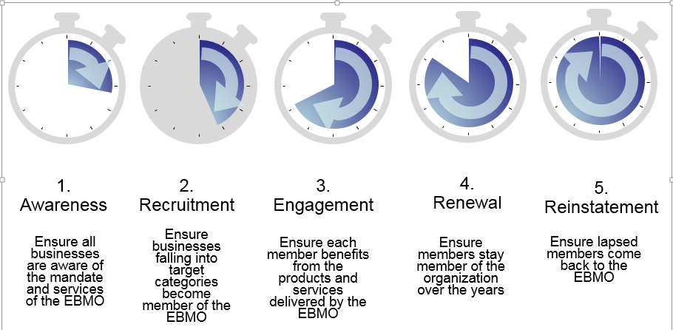
3. Maximizing on Membership Cycle
What does the membership cycle means for EBMOs:

Slide 20
3. Maximizing on Membership Cycle
All EBMOs conduct membership recruitment activities but what happens in many cases is that it is done in an ad hoc or piece meal approach;
From the activities you are conducting,
Which ones respond to which phase of the membership cycle?
On which phase have you concentrated your efforts?
Which phase has been underserved?

Slide 21
3. Maximizing on Membership Cycle
The aim of awareness-raising is two-fold:
to ensure potential members are aware of the EBMO and what it does and
for the EBMO to be aware of the changing needs of members and potential members.
Is the Value Proposition of the EBMO formulated and communicated in an efficient way?

Slide 22
3. Maximizing on Membership Cycle
Where should recruitment efforts of the EBMO focus? Identify priority segments to conduct penetration analysis
Can the EBMO rely on a broad base of members? Can the EBMO rely on segments of the economy having the most weight (GDP)? Are the emerging sectors in membership? Map membership segments to identify if important ones are missed (SMEs? Informal?)
In areas of strong membership – what can we do to attract free riders?
In areas of poor membership – are we responding adequately to needs?

Slide 23
Examples of recruitment tools:
Company visits
Road shows
Emails
Letters with brochures
EBMO’s ambassadors (peer to peer)
Website
Information events
Social media
Advertisement on radio, TV, newspaper
Calls
New Members Info Pack
Collaboration with business promotion agencies

Slide 24
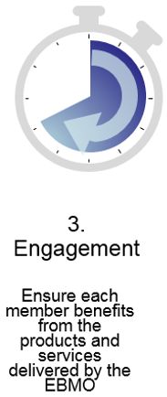
3. Maximizing on Membership Cycle
Retention of existing members is even more important (and way cheaper) than recruiting new members
The Key is to keep members engaged!
How?
By knowing why they join;
By acknowledging (publicly) their joining, their contribution to the EBMO’s work, their success;
By keeping them informed and encouraging them to ACT ie. give their views / comments / inputs on matters of their interest (social media can help); participate to meetings and events etc.;
By responding to their needs (segmentation) and making clear what the concrete value add of activities you organize is;
By measuring engagement and communicating on achievements.

Slide 25
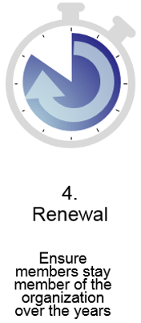
3. Maximizing on Membership Cycle
Subscription renewal should be a straightforward process. EBMOs should show professionalism by sending invoices on time and clearly communicate deadlines (A CRM software is useful in that respect).
Incentives for swift or early renewals can be put in place.
Non payment of subscriptions should be acted upon in line with rules laid out in the Constitution. Remember: in the real world, nobody can buy a good or service for free!
Important for the EBMO is to use the renewal period to communicate on achievements in general as well as individually for each member (what did YOU get out of the membership to our organization …)
The process to fix the level of subscription payments should be open and transparent. Also crucial is to be clear on:
What services are comprised in the membership package covered by the annual subscription fee;
What is not comprised and is available for an extra fee (price for members vs price for non-members).
Exit surveys with members deciding not to renew their membership are very important to improve future retention and reinstatement efforts.

Slide 26
3. Maximizing on Membership Cycle
Former members may be good potential members;
Depending on the reasons for leaving, contacts can be kept in order to assess if circumstances are again favorable for membership;
In any case, clarity on conditions for new membership need to be clear.

Slide 27
We are a solid and reliable partner in the delivery of training for Business Member Organizations and we look forward to assist you in the implementation of your training needs
For further information, please contact:
Programme for Employers’ Activities
^{E-mail: actempturin@itcilo.org}
^{Phone: +39 011 693 6590}
^{http://lempnet.itcilo.org}

