Slide 1
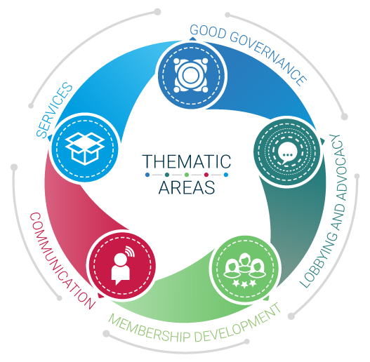
Employers’ Activities Programme Effective Employers’ and Business Organizations
Lobbying and advocacy

Slide 2
What are lobbying and advocacy?
“Actions by employers’ organisations designed to influence laws, regulations and the general attitude and approach of decision makers in socio-economic policy in favour of members”

Slide 3
What are lobbying and advocacy?
“Actions by employers’ organisations designed to influence laws, regulations and the general attitude and approach of decision makers in socio-economic policy in favour of members”
Advocacy
All activities aimed to influence attitudes and
policies … not only – or even – lobbying
Lobbying
A key advocacy tool
… specific activities aiming to make decision makers take a specific stand on a specific issue.

Slide 4
What are lobbying and advocacy?
“Actions by employers’ organisations designed to influence laws, regulations and the general attitude and approach of decision makers in socio-economic policy in favour of members”
Broad spectrum of persuasion
Techniques:
Direct and indirect
Private and public
Ongoing or campaign style
Part of marketing
Advocacy
All activities aimed to influence attitudes and
policies … not only – or even – lobbying
At the core of organisational strategy

Slide 5
Lobbying and advocacy in the context of Employers Organizations
Most EBMOs* have advocacy or lobbying in their vision and /or mission statements
Mission Statement
To remain the premiere employers Organization in the region, by continuously providing valuable services to our members, thereby assisting them in achieving global competitiveness.
IBEC promotes the interests of business and employers in Ireland by working to foster the continuing development of a competitive environment that encourages sustainable growth, and within which both enterprise and people can flourish.
… to encourage workers, their organizations and the Government to co-operate with business for the attainment of the following objectives ….
*EBMOs stands for Employers and Business Member organizations

Slide 6
Lobbying and advocacy in Latin American EBMOs
The Confederation of Private Employers in Bolivia (CEPB) has as its fundamental purpose defend and promote the private initiative, foster the economic and social development of the country, within a framework of ethical principles and values, respect to the law and private property, supporting the free enterprise and economy market philisophy
Its mission consists on promoting – within a frame of ethical principles and values – the environment which allows creation and maintenance of employers initiatives, and the existance of an institutionality which encourages growth and free competition, in order to achieve economic, social and environmental sustainable development
Promote the socioeconomic development in Costa Rica, fostering the progress, competitiveness, and responsible employers practice within the private sector. Aditionally foster the private enterprise through productive sector efforts and the interaction with other social actors, aimed at improving life quality

Slide 7
A Guide for EBMOs
Published in 2018
Tailor-made for EBMOs
Available on http://lempnet.itcilo.org

Slide 8
What is Advocacy?
Advocacy for EBMOs
All the actions undertaken by a EBMO to influence laws, regulations and general attitude and approach of decision-makers in socio-economic policy, in favour of members.
Key to effective advocacy is knowing
What you want to achieve
Why you want to achieve it
Who you will need to convince
How you will go about it

Slide 9
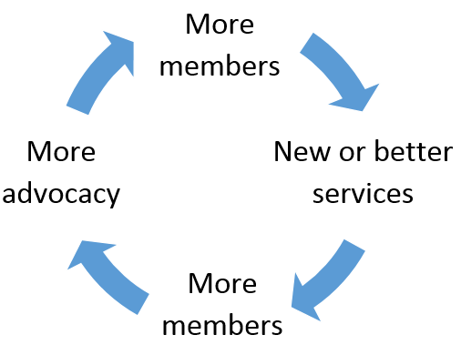
Why Advocacy?
Why Advocacy?
Key reason for businesses to join the organisation:
Virtuous circle -

Slide 10
Focus needed
Focus needed
Crowded space requires EBMOs to:
Seek synergies and commonalities of interest with other civil society groups to ensure stronger voice with more substance; and
Ensure the positions developed for adoption are evidence-based with clear buy-in from members.

Slide 11
Basic principles
Although strategies an EBMO adopts will depend on the issue under consideration and political system in place, three elements of advocacy apply everywhere:
The requirement to have –
Something to say
Someone to say it on behalf of
Somewhere to say it

Slide 12
Something to say - Mandate
Founding documents of an EBMO (constitution, statutes, by-laws, articles of association etc) must set out mandate for EBMO to engage in an issue.
The key objective must be to improve the environment for business which incorporates the principles of an enabling environment for sustainable enterprises.
Important that founding documents are up-to-date. If the mandate to engage is not clear, Government or some other stakeholder could bring intervention to an end.

Slide 13
Something to say – Choosing an Issue
Regardless of mandate, no EBMO can deal with all issues that have an impact on the business environment.
EBMO must undertake an analysis of the national situation and develop a business agenda and a strategic plan to prioritise issues.
ILO tripartite constituents identified 17 pillars for an enabling environment for sustainable enterprises (EESE) which was unanimously endorsed at the 2007 ILC.

Slide 14
Something to say – Choosing an Issue
Peace and political stability
Education, training and lifelong learning
Good governance
Social dialogue
Information and communication technologies
Respect for human rights and international labour standards
Entrepreneurial culture
Social justice and social inclusion
Trade and sustainable economic integration
Enabling the legal and regulatory environment
Access to financial services
Adequate social protection
Physical infrastructure
Rule of law and secure property rights
Responsible stewardship of the environment
Fair competition
Sound and stable macroeconomic policy and good management of the economy

Slide 15
Something to say – Choosing an Issue
The publication and wide dissemination of the EBMO’s business agenda has a two-fold purpose:
To raise public awareness of the importance of a particular issue to business, and
To signal to members and other stake-holders that the EBMO is a serious organisation working on behalf of members.
Three themes are integral to a business agenda:
What is wanted to be achieved,
An identification of the obstacles for private sector development, and
Recommendations for reform and change.
Such documents demonstrate EBMO is driven by policy and not politics

Slide 16
Take a moment to read …
If Employers’ and Business Member Organizations are to be effective in their advocacy efforts, they must have a clear understanding of the objectives they seek to achieve.
It will be useful at this stage for the organization to undertake PEST (Political, Economic, Social, Technological factors) and SWOT (Strengths, Weaknesses, Opportunities and Threats) analyses. The list of potential issues generated through this process will probably be long. The next step will be to refine the list, on the basis of the relevance of the issues to the organization’s members and the likelihood of advocacy success.
When the organization has received its members’ views on advocacy priorities it is time to turn them into the broad advocacy objectives, the National Business Agenda, on which the organization will develop specific campaign plans. At this point it is important to ensure that the advocacy objectives are approved by the Board.
The organization will now have its first real result – the National Business Agenda. This concise list of the advocacy objectives that the organization intends to pursue is a valuable document and deserves broad circulation and a degree of publicity
International Labour Organization, 2005. P.7-11. The Effective Employers´Organization. Guide three, Advocacy. Maximising the Impact of the Voice of Business. http://www.ilo.org/public/english/dialogue/actemp/downloads/projects/eos/guide3_en.pdf

Slide 17
A quick check list: do you have a Business Agenda?
Written lobbying and advocacy strategy?
Clear and written objectives?
Described in terms of desired policy outcomes?
A designated individual responsible for advocacy?
Formal review of the current and future opportunities and threats which your members face in the political, economic and business environment?
Regular and formal method to consult membership to determine lobbying and advocacy issues?
Advocacy strategy and objectives reviewed and approved by Board?
Board formally reviews this strategy at least once per year?
Formal process for keeping members up to date with your advocacy strategy and objectives?
Formal process for reporting to members on your advocacy achievements?
Media strategy that makes you the “media choice” for hearing the voice of business?

Slide 18
Some examples: Business New Zealand

Slide 19
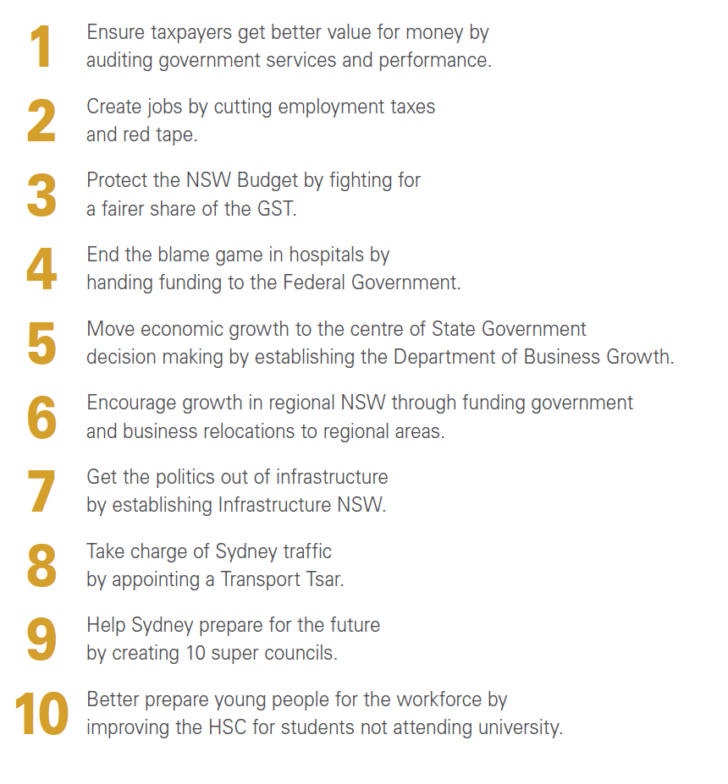

Slide 20
CBI Priorities
1. Access to the people and skills needed for growth 2. World-class enabling industries and infrastructure across the country 3. Globally competitive tax, fiscal policy & regulation 4. The climate and capabilities to innovate 5. Easy and open access to world markets

Slide 21
COHEP – Honduras
National Strategy for Sustainable Enterprise in Honduras.
Objectives
General Objectives
Specific Objectives
Reduce barriers to access to financial services for MSMEs;
Increase the quality of technical training services;
Facilitate the processes of business opening, obtaining permits and payment of taxes;
Introduce improvements to the legal and regulatory framework to support business operations;
Improve the capacity to formulate and execute infrastructure projects;
Strengthen the system of property and credit guarantees;
To have statistical information, continuous evaluation mechanisms to analyze the competitiveness trends of Honduran companies; and,
Build a portfolio of business services, designed to fit the needs of companies according to location, size and activity sector.
Improve the business environment in Honduras;
Promote the development of sustainable enterprises in Honduras;
Establish programs for the creation and expansion of enterprises in Honduras;
Promote the formalization of the business activities of the Honduran population; and,
Improve the efficiency of infrastructure, administrative procedures and business support services in Honduras.

Slide 22
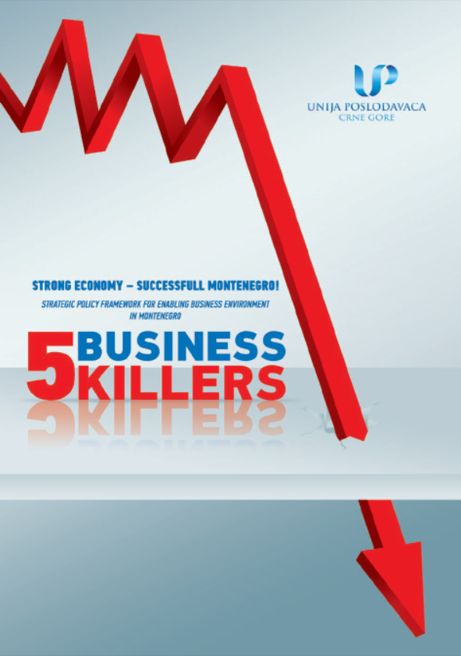
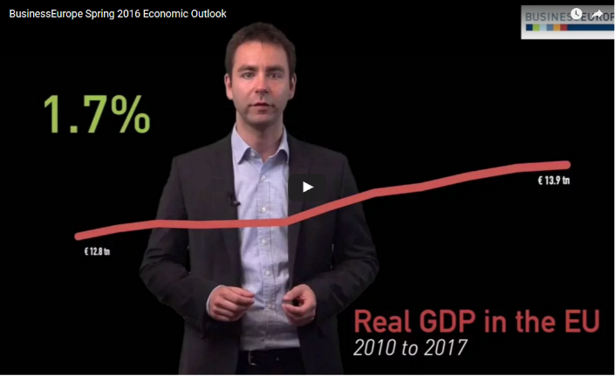
Other examples

Slide 23
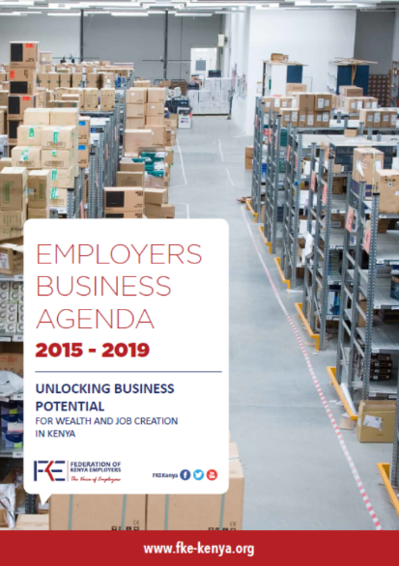
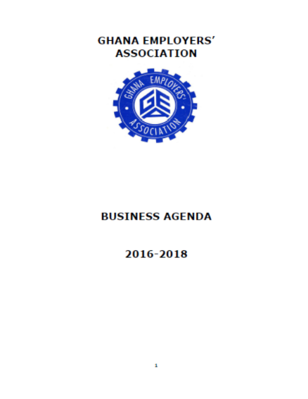

Slide 24
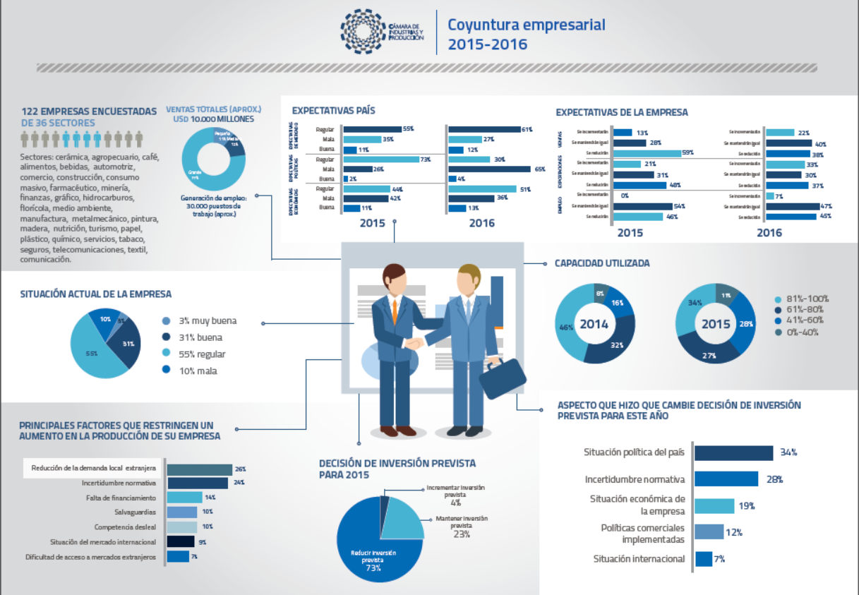

Slide 25
Something to say – Reactive Approach
Plethora of proposals for new regulation use EBMO’s time and resources.
Because of the concern of increasing business costs, often the EBMO response is seen to be negative.
Important to put forward alternative proposals backed by data and examples and to find something positive to say about the proposal.
Often it is points of detail that are objected to, not the initiative itself.
Concerns also arise about implementation issues and precedents.
Always important to state the intention of the EBMO is to work constructively to achieve the best possible outcome.

Slide 26
Something to say – Evidence-Based Positions
Indispensable starting point in developing business agendas and advocating for change are international surveys measuring the ease and costs of doing business, level of corruption and human development.
The objectivity and impartiality of the reports add weight to proactive advocacy.
Comparisons can be undertaken within a geographical region and with similar-sized economies.
Most important is a country’s year-on-year progress within the rankings.

Slide 27
Something to say – EESE Data
ILO ACT/EMP has developed a software tool for EBMOs to support advocacy outcomes: Enabling Environment for Sustainable Enterprises Data – EESE-Data.
Contains seven surveys with over 300 specific indicators
Global Competitiveness Report – World Economic Forum (WEF)
Global Enabling Trade Index - WEF
Networked Readiness Index - WEF
Doing Business – World Bank
Worldwide Governance Indicators – World Bank
Human Development Index – UNDP
Environmental Performance Indicators – Yale and Columbia Universities
More information here: http://eese-toolkit.itcilo.org

Slide 28
Something to say – EESE Data
By using the in-depth country analyses, practical examples can be extracted for use in national advocacy efforts.
The World Bank’s Doing Business Report sets out questions for a country to answer. A EBMO can use the same questions for secondary analysis in focusing on SME issues, for example.
Being part of an international network of EBMOs is a considerable advantage as details of strategic approaches can be sought by direct contact.

Slide 29
Something to say – Cost / Benefit Analysis
Important for EBMOs to undertake own investigation with members as to costs - both direct and indirect – of a proposal.
Direct costs are directly attributable to the policy goal while indirect costs focus on implementation.
The EBMO also needs to identify where the burden is most likely to fall
What are enterprises being asked to do and when?
Will some sectors be more affected than others?
Will the change impact more heavily on women-owned enterprises?
Will the change impact heavily on a growing sector of the economy?
Will the change have more of an impact on SMEs?

Slide 30
Something to say – Cost Benefit Analysis
In the same way, the EBMO should identify the benefits of its proposal and quantify them in monetary terms.
Where there is uncertainty, this should be made clear and the assumptions spelled out.
The extent to which other stakeholders might be affected by the proposal should be identified to strengthen the EBMO’s case.
It is useful to provide practical examples of what the figures mean to local businesses.
Crucial that what is said is clear, precise, backed by evidence and offers constructive options for a way forward.

Slide 31
Someone to say it on behalf of - Members
An EBMO’s greatest asset is its members. They give it the validity to meet the ILO’s requirement of being “the most representative organisation of employers” with which the Government is obliged to consult.
Having status alone will not be enough to automatically sway opinion in favour of the EBMO’s position. For members to value the EBMO’s advocacy efforts:
Advocacy must be on behalf of the entire membership / business community.
Members must be given every opportunity to be involved at all stages of the advocacy process.
Communication with members is essential as amendments or fall-back positions may have to adopted.
A full evaluation of the process and outcome must form part of strategy.

Slide 32
Someone to say it on behalf of – Internal Buy-in
To ensure both EBMO staff and Board members understand the reason for a proposed intervention, the following questions must be answered:
What is the problem with the status quo that warrants intervention?
Have circumstances changed or something specific happened that makes the current system untenable?
How much time is there to rectify the situation – is immediate action called for or is a longer-term plan of action appropriate?
What outcome does the EBMO want?

Slide 33
Someone to say it on behalf of – Intervention Framework
Once agreement reached that issue is a priority, a committee of the Board or ad hoc group of key members should be established to prepare an Intervention Framework (IF) setting out the activities, timeframes, responsibilities, expected outcomes and resource allocations.
The IF will be the guiding document for the basis of collaboration with other stakeholders.
It must be remembered that advocacy is a dynamic process requiring the EBMO to be flexible and well-prepared with fall-back positions.

Slide 34
Someone to say it on behalf of - Collaboration
As part of the preparations for an advocacy effort, a full analysis of stakeholders must be identified so synergies can be identified and built on.
Depending on the issue at hand, interested parties are likely to be much broader than merely other business groups.
Churches, women’s groups, community groups, academics, environmentalists and interested individuals may well be potential collaborators with a EBMO to give wider acceptance of an adopted position.

Slide 35
Someone to say it on behalf of - Coalitions
Formal coalitions of business groups are useful to co-ordinate advocacy issues.
Coalitions can be on-going, formalised structures or created to deal with a single issue only.
Having a formalised coalition presupposes that the key principles espoused by the EBMO are common to all organisations which makes acting in concert more effective.
All coalition partners must reach agreement on what is to be said, who is to say it, and where it is to be said.
Important that the business community does not give contradictory messages.

Slide 36
Someone to say it on behalf of – Large / Foreign-Owned Companies
Many large / foreign-owned companies do not see value in joining a EBMO as they often have direct access to decision-makers so do not need a EBMO to speak on their behalf.
Given their status, however, it is important that EBMOs form a close relationship with such key players.
It is necessary to know where their interests diverge from the EBMO’s position on behalf of its members so that discussions can be held to ensure no disadvantage occurs to other companies if concessions are granted.
Large / foreign-owned companies could be encouraged to join a national EBMO as part of its corporate social responsibility programme.

Slide 37
Managing Conflict of Interest Among Members
The EBMO must balance and attempt to reconcile differing interests to ensure the best possible result for all members.
Priority-defining documents (strategic plan and business agenda) are a defence against allegations of a EBMO favouring one group or sector over another.
As advantages or disadvantages can occur over a period of time after implementation of a proposal, it is important to undertake continued evaluation of policy changes to report to members the long-term effect.

Slide 38
Managing Conflict of Interest Among Members
The leadership of a EBMO will have to manage differing views and expectations of members, proactively.
If a member cannot be influenced or persuaded to support the EBMO position then every effort should be made so that open disagreement does not occur.
Having articulated policy principles ensures members will not be taken by surprise.
Keeping members involved in all phases of policy development is crucial to success.

Slide 39
Somewhere to say it – “Soft” or “Hard” Advocacy
Lobbying, the more formal interface with Government, is just one part of advocacy.
Because lobbying is carried out in the public eye, it is often classified as “hard” whereas day-to-day activities of a EBMO which more subtly persuade and influence are “soft”.
Deciding the place where advocacy will be carried out determines:
The appropriate message for the specific audience
The manner in which it is to be delivered
Who the best person or organisation to deliver the message is
In what order the different audiences will be approached
How much each segment will cost

Slide 40
Somewhere to say it – On-Going Discussions
EBMOs should meet regularly with decision-makers and establish open channels of communication and close working relations with government officials.
Such regular meetings help to sensitise decision-makers to business concerns.
In all dealings with members, all staff and elected officials of a EBMO need to listen to concerns and report them back for inclusion in policy responses.

Slide 41
Somewhere to say it – In-House
A EBMO’s website is a key tool in advocacy as links to deeper analyses of an issue including research papers and comparisons with similar economies can be established.
Alerting members by email to new material posted on the website enables them to keep abreast of developments as well as raising profile of EBMO.
Regular meetings with HR or IR practitioners enables networking as well as enabling the EBMO to be apprised of developing issues from a practical perspective.

Slide 42
Somewhere to say it – Use of Media
The media are a key tool to influence public opinion and persuade the general public that the concerns of the business community are important.
Too often the only time a EBMO is reported in the media is when it is objecting to a government proposal.
Regular meetings with newspaper editors, television news producers and building contacts with reporters are important as are regular radio / television / newspaper slots to set out the business message.
Social media plays a key role in disseminating key messages
See the ACT/EMP ITC-ILO Guide: Making sense of social media – a practical guide for Employers’ Organisations

Slide 43
Somewhere to say it – Specific Issue
All elements of advocacy lead into the Intervention Framework.
It should stipulate where the different phases of advocacy are to be carried out and who the various audiences are.
It should also identify key messages and what is required to support those messages.
Key messages will also determine whether a “soft” or “hard” approach is better.
If all positions are based on policy principles supported by compelling arguments backed by research, then a “hard” approach will be accepted as the EBMO acting purposefully for its members.

Slide 44
Somewhere to say it – Costs of Advocacy
Because of dynamic nature of advocacy, difficult to provide exact budget.
Driven to large extent by where the message will be given.
The importance of the issue will usually determine how much will be spent.
Headings of costs include:
Personnel expenses (EBMO staff, consultants)
Data expenses (purchase of data, analysis)
Meetings and consultations (venues, catering, transport)
Reports (writing, printing, distribution)

Slide 45
Somewhere to say it – Costs of Advocacy
Having an indication of costs means the following can be addressed:
What is possible in terms of the EBMO’s resource base – both human and financial?
Is the issue important enough that it could garner additional resources from members / other sources?
How could partnerships reduce the EBMO’s costs?
Can particular member companies take the lead on a given issue and bear part of the costs?

Slide 46
Conclusion
Advocacy begins with a problem or perception that there is a better alternative to a current condition.
Advocacy seeks to resolve that problem or implement the selected alternative.
There are no strict rules for advocacy.
Approaches must be culturally, socially and politically specific to each country and each EBMO.
MUST be based on policy positions developed with input from all members and backed by robust research.

Slide 47
We are a solid and reliable partner in the delivery of training for Business Member Organizations and we look forward to assist you in the implementation of your training needs
For further information, please contact:
Programme for Employers’ Activities
^{E-mail: actempturin@itcilo.org}
^{Phone: +39 011 693 6590}
^{http://lempnet.itcilo.org}

