Slide 1

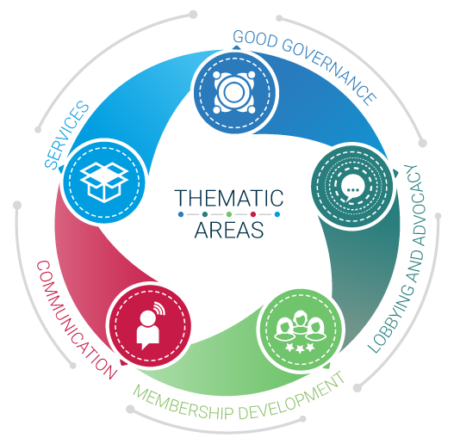

Employers’ Activities Programme
Effective Employers´ and Business Organizations
^{Persuasive}
^{Communication}

Slide 2

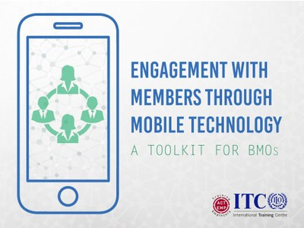

Persuasive Communication
Available resources on
lempnet.itcilo.org

Slide 3
Persuasive Communication
Persuasive Communication
COHERENT
SYSTEMATIC
CONSISTENT
MISSION
VISION
VALUES
TARGETED
TAILORED
EVIDENCE-BASED
COMMUNICATION PLAN
Notes:
Source: Persuasive communication. Making the voice of business heard, ITCILO

Slide 4
External vs Internal Communication?
Persuasive Communication
Internal communications is different from organizational communication
… But needs same professionalism
Communication with members also calls for a strategic approach
… And for the development of the right tools

Slide 5
Strategic approach to Communication with Members – what does it entail?
Persuasive Communication
DEFINE THE GOALS
MOBILIZE THE RESOURCES
USE THE MOST EFFECTIVE TOOLS
1
2
3

Slide 6
Strategic approach to Communication with Members – what does it entail?
Persuasive Communication
DEFINE THE GOALS
Recruit new members?
Win the loyalty of current members?
Boost the knowledge and skills of members
e.g. through training?
Mobilize members to deal with a specific issue
e.g. lobbying?
1

Slide 7
Strategic approach to Communication with Members – what does it entail?
Persuasive Communication
MOBILIZE THE RESOURCES
Financial resources may restrict your chance of developing
specific communication tools. Decide on your priorities
Human resources: Do you have a communications
manager within the staff?
2

Slide 8
Strategic approach to Communication with Members – what does it entail?
Persuasive Communication
USE THE MOST EFFECTIVE TOOLS
What are the tools you use?
How effective are you?
3
1. GET YOUR MESSAGING RIGHT!
2. CHOOSE THE RIGHT CHANNELS!
3. COLLECT, ASSESS, IMPROVE!

Slide 9

1. Get your messaging right!
Left brain
  Rational
  Intelligence
  Language
  Analysis
  Logic
  Evaluation
  COLD
  SLOW
→ exhaustive verification,
step by step
Right brain
  Relational
  Spatial
  Associative, imaginative
  Visual
  Global
  Synthetic
  Artistic
  WARM
  IMPETUOUS
→ endlessly anticipating,
no verification

Slide 10

Messaging
1. Get your messaging right!
Convince = win the ‘battle’ between your audience’s right and left brain
  Right brain: desire for a solution: PROMISE
  Left brain: fright of the solution: PROVE
  Right brain: desire for action: DRAG ALONG
  Left brain: fright of action: REASSURE
PROMISE
PROVE
DRAG ALONG
REASSURE

Slide 11
Promise…prove
Read the following examples: which one is more efficient to “promise” and “prove”?
(1) Our organization has more influence today than it used to have before.
Therefore I’m convinced that we need to use that force now to ask government to wait one more year before increasing minimum wages.
(2) Our organization has more influence today than it used to have before.
Two years ago it took us 4 weeks on average to have an appointment with the prime minister. Today it is a matter of hours.
Twice a week I get a call from the prime ministry’s office to ask for some clarifications. Let’s use that opportunity to make our points clear now!
(3) Shall I call the prime minister tomorrow to ask for an appointment end of this week to explain that increasing the minimum wages now will kill the economy?

Slide 12
Drag along…reassure
Read the following examples: which one is more efficient to “drag along” and “reassure”?
(1) Dear colleagues we have to work out our strategy for 2016 to 2018 before the end of the month. We are already late. If we do not do this in time we will have major problems with the board.
(2) We need to finalize our strategy for 2016 to 2018. This will enable us to communicate our work to the board well in time. This will benefit us all because they will have enough time to make the decisions we are waiting for.
(3) Dear colleagues, I know you are all very busy and I have taken a look at your agenda’s for the coming 2 weeks. I have noticed that we can all afford to take 2 full days and finalize the strategy together for 2016-2018. I have made a lot of preparatory work and 2 days will be more than sufficient.
Use what you just learned to improve your EBMO’s messages.

Slide 13

Arguments
1. Get your messaging right!
3 types of arguments to convince
  'HEAD' arguments: intellectual, thought, idea
  'HEART' arguments: emotional, sharing
  ‘HANDS' arguments: action, experience

Slide 14
Constructing a Message
1. Get your messaging right!
Try it out! Write a communication piece for your EBMO following the process below:
Step 1: Conclusion: what do you want your audience to remember,
to decide or to do?
Step 2: 'Head' argument: intellectual, thought, idea, figures
+ example(s) (Promise + prove)
Step 3: 'Heart' argument: emotional, sharing, what’s in it for us
+ example(s) (Promise + prove)
Step 4: ‘Hands’ argument: action, experience
+ advantage of action (Drag along + reassure)
Step 5: Conclusion: reminding the key idea - What do you ask your audience in terms of 'winning' action?
Notes:
Step 1: Conclusion: 2-3 phrases summarizing your point
What do you want the audience to remember or to do?
Which decision should they take?
Step 2: 'Head' argument: intellectual, thought, idea
Impact on the functioning of the organization?
What rational element(s) do you want to use to make your point?
(Promise + prove, with examples)
Step 3: 'Heart' argument: emotional, sharing
Involve your audience in the problematic
What’s in it for them?
(Promise + prove, with examples)
Step 4: ‘Hands' argument: action, experience + advantage of the action for your audience
What is the action you require
(Drag along + reassure!)
Step 5: Conclusion
Reminding the key idea. What do you ask your audience in terms of 'winning' action?
EXERCISE:
Scenario 1:
We are in front of 100 potential members
We need to convince them that they should join our EO
The problem is that…the economic crisis is there
You know that many people present have difficulties, some are nearly bankrupt
How will you convince them to join?
Scenario 2:
Your are preparing a tour of the country by your Executive Director
The purpose of the tour: get some visibility because on average, 30% of members do not pay their fees
Your EO needs the money desperately because without it, the program of next year will be in trouble
You tried to get the money through mails and letters but…to no avail
You were asked prepare a presentation of 6 minutes maximum
He will meet members from all sectors
It is crisis and you know that many members are in a difficult economic position
How will you convince them?
Use the technique you just have learned

Slide 15
2. Choose the right channel
The “Right” channel will depend of the audience you want to reach:
Members
Stakeholders:
Business community
Government
Consumers
Workers
Media, General public,
think tanks

Slide 16
Examples of tools
Top 1 tool: website: visibility, ‘low cost’ per contact
  Special member section
    Services, trainings, special events
    Q&A
    Surveys, polls
E-zine members
  Monthly
  Topics per specific department/ area of interest
Events
  Evaluation of interest, feed-back (oral or with simple feed-back form)

Slide 17
Examples of tools
Road shows
  Interesting to recruit new members
  Decentralized (province, area, city)
  Presentation of:
    Specific actual topics in relation with members/future members
    Your approach of these topics + benefit for members
    Achievements
    Membership program
Advertising
  Increase visibility of organization
  No real immediate return

Slide 18
Examples of tools
Direct mailing (recruitment of new members)
  Should be in relation with a specific event or activity with a certain benefit: for ex. Invitation to an event, a road show, a training
  Return is low: 4% average
General Annual Meeting and annual report
  Opportunity to take stock of your activities
  Explnatory summary should be made for members
  Add a specific topic each year?

Slide 19
Communication … in today’s world
We are (...) a social networking species with an innate need to connect and communicate (...) via short messages, a behavior we learnt millenia ago.
That is why we are inevitably moving towards the Mobile Society... Because any technology that allows us to better connect, communicate, share knowledge and information and get stuff done will be widely adopted
A. Moore, The Glittering allure of the mobile society, 2008.

Slide 20







Communication … in today’s world
EBMOs taking advantage of the mobile society
Mobile technology makes it possible to:
Access & receive information anytime/anywhere
Give feedback & increase interactions
Communicate and engage in discussions with a low barrier to entry
Enlarge one own’s network beyond geographical boundaries
Benefit from tailored and attractive services

Slide 21
Communication … in today’s world
Mobile technology makes it easier for EBMOs to:
Deliver content
Gather feedback
Provide support
Ensure continuous engagement with members
Find out more on tools available for FREE and how to use them here

Slide 22


Communication … in today’s world
In addition to the Communication strategy and tools of the EBMO (web presence through website, dedicated applications (Apps) etc.), the EBMO staff can engage with members using mobile technologies eg. to:
Open and manage discussion forum with members on priority issues
Send SMS reminding members of the future General Assembly /Board /Working group meetings
Disseminate complementary information on policy papers adopted by the organization (sms summary; infographic; etc.)
Mobile learning service to complement existing workshops
Send short information on BMO’s activities, priorities, main future events
Perform needs surveys
Send targeted information to potential members in the framework of a membership recruitment campaign
Perform evaluation and assessments of the BMOs activities
Deliver advisory services on demand
Market services offered by the BMO

Slide 23
What will success look like?
3. Collect, Assess, Improve
Set tangible targets
Don’t be too ambitious – build relationships
Get involved
Be prepared to listen
Engage and your communications will evolve

Slide 24

We are a solid and reliable partner in the delivery of training for
Business Member Organizations and we look forward to assist you
in the implementation of your training needs
For further information, please contact:
Programme for Employers’ Activities
^{E-mail: actempturin@itcilo.org}
^{Phone: +39 011 693 6590}
^{http://lempnet.itcilo.org}

