Slide 1
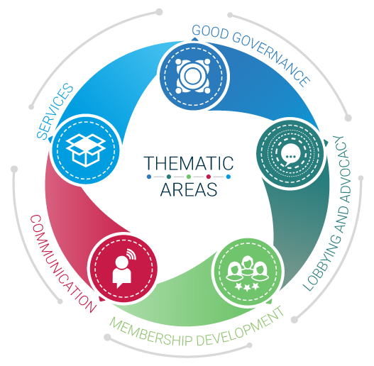
Employers’ Activities Programme Effective Employers’ and Business Organizations
Employers Organizations and
Services development

Slide 2
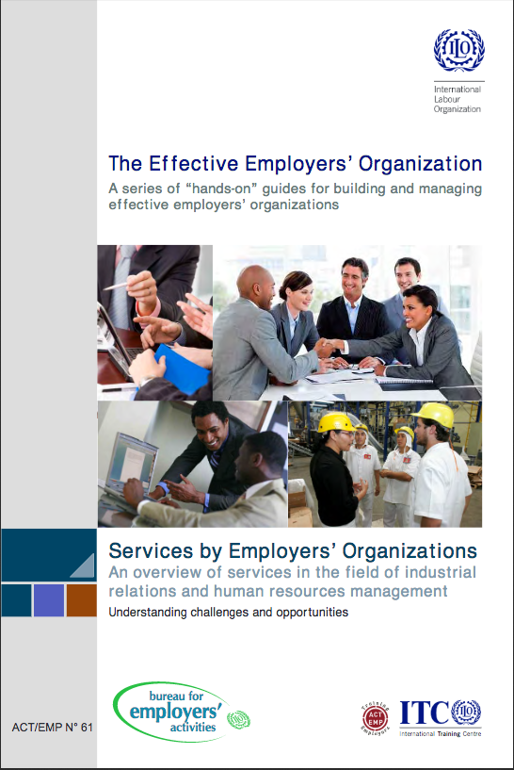
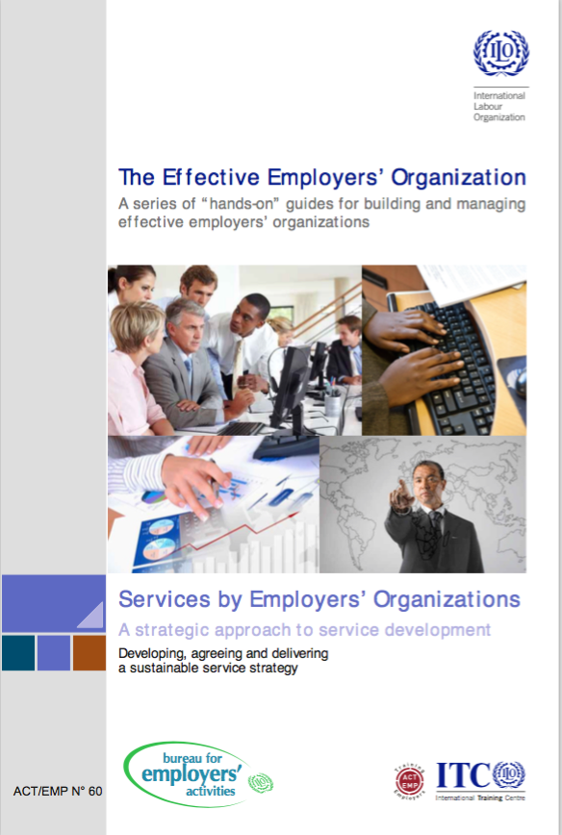
A series of 3 Guides

Slide 3
A series of 3 Guides
3 Tailor-made Guides for EBMOs – Employers and Business Member Organizations:
“A strategic approach to service development” is the cover-guide of the series. It provides a general approach to service development, regardless of the types of services and aims to help the management and staff of EBMOs to adopt an effective business model for membership services.
Two other guides: “Services by Employers Organizations: An overview of services in the field of Labour Law” and “Services by Employers Organizations: an overview of services in the field of industrial relations and human resources” go in detail on the contents of specific services.
Published in 2012
Available on http://lempnet.itcilo.org

Slide 4
EBMOs have two main functions
Voice of Business
i.e. actions designed to influence laws, regulations and the general attitude and approach of decision makers in socio-economic policy in favour of members
Service provision
i.e. responding to the specific needs of businesses in terms of knowledge/information, capacity to do business or support to business activities

Slide 5
Challenge: Get the balance right!
Often membership subscriptions are not sufficient to support advocacy role
Often members do not wish to pay membership subscription merely for advocacy
Offering services is a way to generate income and enhance members’ fidelity
It is important to get the right balance between the two functions
ADVOCACY
SERVICES

Slide 6
Challenges for EBMOs
Offering quality services to members, that add value to their businesses
=
Services that help members to enhance their performance and competitiveness

Slide 7
Advantages for EBMOs
offering quality and value services
at a competitive price
and reduce the dependency
on subscription
Retain and
recruit members
Increase income
EO’s
VALUE
become more visible among
current members and
potential members
identifying current issues
And offer solutions
Enhance profile
Meet members’
expectations

Slide 8
Service development strategies
Service development needs to be carefully thought through!
Ad hoc launching of services in the hope of solving cash flow for the organization is risky in terms of financial and reputation loss!

Slide 9
Service development strategies
The following slides propose a methodology to design or review service development strategies in EBMOs;
It is proposed to apply a business plan process to services provision;
The process is explained step by step.
It is most helpful if you take the time to reflect on each step and apply it to your own EBMO situation. This can be done in groups.
Other practical tips and concrete examples can be found in the ITCILO Guides.

Slide 10
3 key elements of strategic management
Strategic
Position
Strategy
Strategic
into
Choices
Action
JOHNSON & SCHOLES, 2005

Slide 11
… which answer 3 key questions
Where are we now?
Strategic
Where do we want to be?
Position
How do we get there?
Strategy
Strategic
into
Choices
Action

Slide 12
Long term
Strategic
Position
Strategy
Strategic
into
Choices
Action

Slide 13
Short term
Strategic
Position
Strategy
Strategic
into
Choices
Action

Slide 14
Business plan

Slide 15
Where are we now?
Where are we now?
Market analysys
Strategic
Position
Strategy
Strategic
into
Choices
Action

Slide 16
Strategic position: where are we now?
Activity
Market analysis
Key elements
Supply
Demand
Service Audit Matrix
Competitors Analysis
Tools
Members’ needs

Slide 17
Market analysis - Supply
Service audit matrix
Purpose: to provide tools to decide which services
May be kept unchanged
Need to be restructured / repackaged
Need to be dropped
Having the courage to discontinue or restructure some services is essential to continue being relevant!

Slide 18
Market analysis - Supply
Service Audit Matrix (SAM)
Criteria
Why has the service been developed?
How often is it used?
How many members/clients use it? + information on size, region, branch
Does it cover costs/generate profit? If not, give good reasons for maintaining it in the offer
How is it delivered (use of internal / external experts, outsourcing)? Is it easy to deliver or complicated?
Is the service in the mainstream of your activity or not? Is it linked with EO strategic objectives?
How many people are engaged in providing this service? Are their competencies in line with the service activity?
Is it posible to get it cheaper from the market? Is the quality of service similar?

Slide 19
Marketing analysis - Supply
Analyze the competitors
The strength of competition can affect the activity of your organizations in setting up new services or improving existing ones
You need to know if similar services are already provided and by whom
It is necessary to include current competitors as well as future/potentials in the analysis

Slide 20
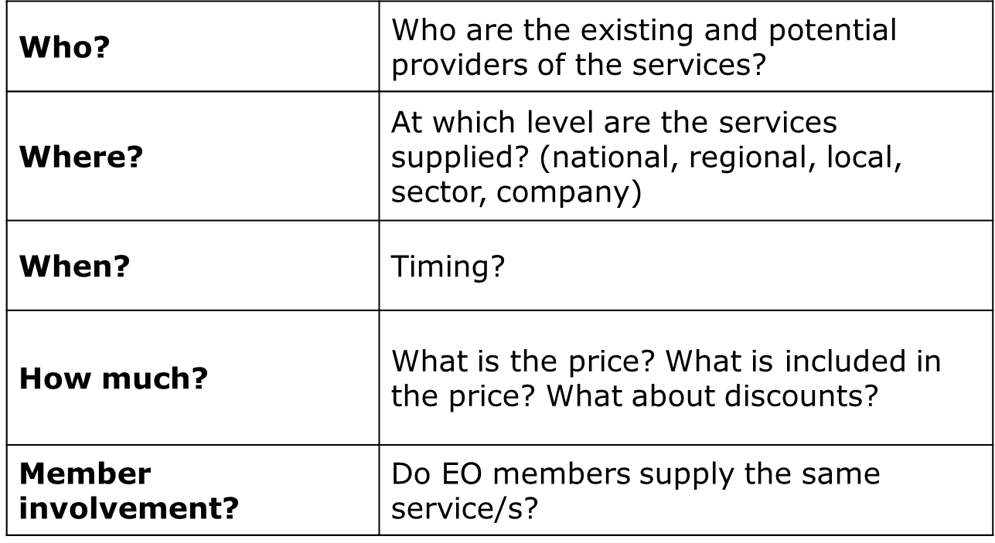
Marketing analysis - Supply
Competitor Mapping: Identifying the key competitors

Slide 21
Market analysis - Demand
Why is it important to know members’ needs?
To understand your current and potential positioning in service provision
To understand your potential clients/members
Do you know what your members’ needs are? Who can you ask? Which tools can you use?

Slide 22
Market analisys – Demand
WHO CAN YOU ASK?
Make use of internal EBMO channels
The Board
Standing Committees or working groups
Key members
Members
Potential members

Slide 23
Market analysis - Demand
DIFFERENT TOOLS ARE AVAILABLE – EBMOs should use a mix
Formal sample or census survey –internet, mail, phone;
Quantitative data:
Structured face-to-face or telephone interviews;
Member panels or focus groups
Regular conferences, member briefings or training events;
“Bumping into members” during the course of work.
Qualitative data:

Slide 24
Where do we want to be?
Setting objectives
Strategic
Where do we want to be?
Position
Strategy
Strategic
into
Choices
Action

Slide 25
Types of service
Many types of services are currently provided by EBMOs around the world, such as:
Information
Research and business survey
Legal representation
Advice and consultancy
Networking
Trade and market development
Training
Certification
Office facilities, infrastructure services and discount
Check for further examples in the ITCILO Guides and videos

Slide 26
Legal Framework and Mandate
Make sure that the provision of the service is in line with:
Your national legal statutes
The mandate given to the organization by the Board

Slide 27
How do we get there?
Operational Business Plan
Strategic
Position
How do we get there?
Strategy
Strategic
into
Choices
Action

Slide 28
Operational Business Plan
Step 1. Define the objectives and target group | For which members segment? Why offering the service? Which is your value proposition? How many members are expected to use the service (in 1 year)?
Step 2. Preliminary assessment | Delivery options and specific competitors
Step 3. Marketing mix Strategies | 7 Ps strategies

Slide 29
Step 1. Define the objectives
Questions to help set short term objectives for each specific service :
For which members segment?
Why offering the service? Which is your value proposition?
By when?
How many members are expected to use the service (in 1 year)?

Slide 30
Step 1. Define the objectives
Questions to help determine the segment for each specific service :
List of target groups; differentiated by type (association/micro enterprises / SMEs / big companies member/non-member etc.)
Characterize your target groups: what is their main business? What are their roles in the companies?
Do they have experience with service provided by your EOs?
Do you intend to attract only members or non-members as well? And if yes, what are the main differences between them?

Slide 31
Step 1. Define the objectives
Questions to help determine the value proposition for each specific service:
What’s your members’ Pain (= what problem do you want to help improve/solve)?
What makes your offering so unique (= what do members gain by your service?)
PAIN | GAIN
Fears Frustrations Obstacles | Wants/Needs Measures of success Obstacles

Slide 32
Operational Business Plan
Step 1. Define the objectives and target group | For which members segment? Why offering the service? Which is your value proposition? How many members are expected to use the service (in 1 year)?
Step 2. Preliminary assessment | Delivery options and specific competitors
Step 3. Marketing mix Strategies | 7 Ps strategies

Slide 33
Step 2. Preliminary Assessment
Questions to help conduct a preliminary assessment:
Do you have internal human and financial capacity to design and deliver the service
With whom should you partner with?
Which would be your main competitors on the specific service?

Slide 34
Step 2. Preliminary Assessment
Different Delivery Options exist:
DIRECT PROVIDER
Direct distribution
EO delivers service with its own staff
EO Level of involvement
PARTNERSHIP
EO establishes an alliance for delivery of services
OUTSOURCING
Indirect distribution
EO contracts a firm to deliver the service on his behalf
REFERRAL
EO connects its members with existing service providers

Slide 35
Step 2. Preliminary Assessment
What partnership you need to establish and with whom?
Generally speaking: the network of suppliers and partners who complement each other in helping the organization creating and delivering services.

Slide 36
Step 2. Preliminary Assessment
Questions to guide a competitor analysis:
What are your main competitors in the market?
What are their main clients?
Which kind of service do they offer? What are main contents? Which methodology do they use?
What do you know about their reputation?
Do you know of any feedback being positive or negative on concrete results and benefits of the service?
Does it operate with the institutional support of the government? Or an international organization? What does that imply?
Does it address the same thematic areas as your future service?
How much does it cost to sign up for it?

Slide 37
Operational Business Plan
Step 1. Define the objectives and target group | For which members segment? Why offering the service? Which is your value proposition? How many members are expected to use the service (in 1 year)?
Step 2. Preliminary assessment | Delivery options and specific competitors
Step 3. Marketing mix Strategies | 7 Ps strategies

Slide 38
Step 3. Marketing mix: the 7 Ps

Slide 39
Step 3. Marketing mix: the 7 Ps
Questions to help adapt the marketing mix strategies (7Ps) to EBMOs’ service provision:
PRODUCT: What they are the main value-adding features and key selling points of your service?
PLACE: which are the most efficient distribution channels for the service? Note: Proximity is an important advantage.
On site
Phone
Mail and E-mail
In - house
Website

Slide 40
Step 3. Marketing mix: the 7 Ps
PRICE: 3 factors determine the pricing strategies, they are:
Different pricing options can be chosen for each service. However, it is always crucial to calculate the full-cost of each service (including labour costs and overhead).
Cost of service
Competitive analysis
Business model
Making profit with the services
Cross – subsidization with other sources
Cost – covering without profit making
For free

Slide 41
Step 3. Marketing mix: the 7 Ps
PROMOTION = How to you get in contact with your members?
What are our channels to reach members?
How to reach customers online and using social communities?
What ways do our members/customers prefer to be contacted?
Who and how do they contact you?

Slide 42
Step 3. Marketing mix: the 7 Ps
PROCESS = How to you interact with your members?
How do members interact with you through the sales and service lifecycle?
How do you measure members’ satisfaction?
What are some good examples of building member relationship?
How can you innovate in building member relationships?

Slide 43
Step 3. Marketing mix: the 7 Ps
PHYSICAL ENVIRONMENT: when members consume your service, how is the space like? Thinks like ambiance, building/room standards (eg. OSH), layout, branding have an impact.
PEOPLE:
People capacities largely influence the quality of the service
Staff capacities are: knowledge, skills, attitude
Which internal staff will be involved in design, promotion and delivery of the service?
Do we have standards of delivery? Shall we plan capacity-building?

Slide 44
We are a solid and reliable partner in the delivery of training for Business Member Organizations and we look forward to assist you in the implementation of your training needs
For further information, please contact:
Programme for Employers’ Activities
^{E-mail: actempturin@itcilo.org}
^{Phone: +39 011 693 6590}
^{http://lempnet.itcilo.org}

