Slide 1
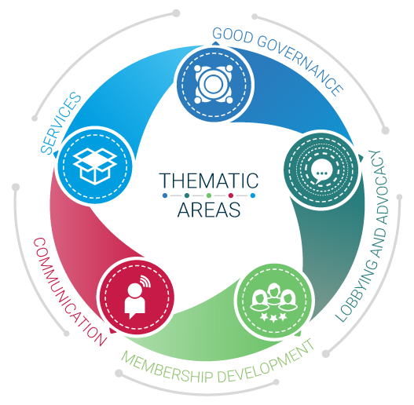
Employers’ Activities Programme Effective Employers’ and Business Organizations
Good and effective
Governance in EBMOs

Slide 2
A guide for EBMOs
Published in 2018
Tailor-made for EBMOs (Employers and Business Member Organizations)
Available here: https://lempnet.itcilo.org

Slide 3
What is governance?
Governance must be distinguished from Management
In an EBMO, there is a clear difference between the Board’s responsibilities (governance) and those of the Chief Executive Officer (management).
Governance is the responsibility of the elected representatives of the membership who comprise the Board. The Chairperson of the Board(also known as the President of the EBMO) is ultimately responsible for good governance and for ensuring that the boundaries between governance and management are respected and maintained.
In other words, Governance determines the “What?” (what the EBMO does and what it should become in the future), while management determines the “How?” (how the EBMO will attain those goals and aspirations).

Slide 4
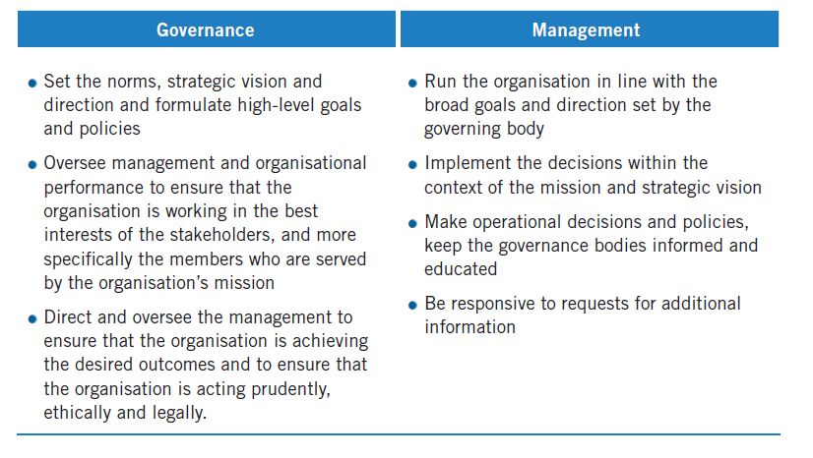
Governance vs Management

Slide 5
Basic Principles of Governance
There are three elements to good governance, namely the requirements for
independence
clarity
transparency

Slide 6
1. Independence
Independence from states/government means:
The EBMO is a non-aligned, apolitical organization;
It does not depend on state funding for its functioning.
Independence from factions or particular interests groups means:
The EBMO has a large and inclusive membership;
All interests are dealt with in a balanced way.

Slide 7
Dependence from factions vs Good governance

Slide 8
2. Clarity
Where there is a lack of clarity, there is room for discretion to be exercised which gives rise to the perception that the EBMO is not acting consistently – or worse, that it is acting improperly.

Slide 9
2. Clarity
Ways to ensure clarity:
Founding documents are adopted and up-to-date;
Conflicts are resolved in a transparent way;
Fee setting mechanisms are enshrined in the founding documents which are publicly available;
Consequences of non-payment of fees are clear and applied consistently;
Procedures for elections and mandates for elected functions are written down and respected;
Terms for office and procedures of removal from office are written down and applied;
Balanced reflection of diversity is sought;
Compliance is given the highest priority.

Slide 10
3. Transparency
Corruption – including bribery and extortion – has been increasingly identified by the business community as the biggest contributor to lack of good governance, leading in turn to low investment and stymied economic growth.
EBMOs have a responsibility to fight corruption at national level through advocacy initiatives and to ensure good governance in their own organization

Slide 11
3. Transparency
Ways to ensure transparency:
Leading by example: systems supporting good governance must be in place and any breach must be acted upon immediately in a open manner;
Code of Ethics for staff and Board members: to raise awareness and foster ownership at all levels of the values of integrity, honesty and loyalty to the organization;
Encouraging and Educating Members: providing support and guidance to members companies and their employees on how to address cases of bribery, extortion or other corrupt practices.

Slide 12
Checklist
Is your EBMO’s Constitution up to standard?
Are rules on the composition and functioning of your institutions (Board of directors, Committees etc.) clear and consistent?
Have a look at the available tools on good governance on http://lempnet.itcilo.org

Slide 13
To remember
Good governance is a key element of the credibility of an EBMO & it is critical for its ability to attract and serve members;
EBMOs have different instruments to ensure good governance (Constitution; Boards and Committees; Management and secretariat etc.) – periodic reviews should be carried out;
If good governance is a priority, resources need to be allocated.

Slide 14
We are a solid and reliable partner in the delivery of training for Business Member Organizations and we look forward to assist you in the implementation of your training needs
For further information, please contact:
Programme for Employers’ Activities
^{E-mail: actempturin@itcilo.org}
^{Phone: +39 011 693 6590}
^{http://lempnet.itcilo.org}

