Slide 1
SERVICES DEVELOPMENT

Slide 2
LET’S EXPLORE THE THEMES OF THIS COURSE
1. The role of EBMOs: main accent on policies or services?
2. Sounding out the market: demand and supply analysis
3. Key ingredients for successful services
4. Which services? Innovative and emerging services: What and How?
5. Cost, Price, and Service Sustainability
6. Legal mandate, delivery options and the marketing mix
7. Monitoring & Evaluation

Slide 3
LET’S EXPLORE THE THEMES OF THIS COURSE
1. The role of EBMOs: main accent on policies or services?
2. Sounding outthe market: demand and supply analysis
3. Key ingredients for successful services
4. Which services? Innovative and emerging services: What and How?
5. Cost, Price, and Service Sustainability
6. Legal mandate, delivery options and the marketing mix
7. Monitoring & Evaluation

Slide 4
To start with…
Isn’t business representation the main raison d’etre of Employers and Business Membership Organizations (EBMOs)?
Are all activities conducted by EBMOs for members to be defined as "Services"?
What drives EBMOs to offer services to members?

Slide 5
WHAT ARE THE EO-EBMO ESSENTIAL ROLES
Leadership
Representativeness-power
Values
Culture
Member engagement
Subscription
EBMO
Retention
Recruitment
Management
Secretariat
Member satisfaction
Policy influence for better BE
Services for members
Notes:
Recap: What is a EBMO? Which form does it take? Which functions does it fulfil?

Slide 6
SERVICES: WHY WOULD YOU OFFER THEM?
Small Debate Among Participants (3 Groups)
What are the pros and cons, opportunities, and risks of investing (more) in developing services? What are your objectives with services?
List pros and cons from different viewpoints:
membership
sustainability
resource utilization
competency
core business and mission
and other concerns
If possible, include indicators of success
A spokesperson summarizes after a 10-minute group debate for the plenary.
Notes:
Your conclusion? More or fewer services? What precautions in your context to determine your strategy?

Slide 7
Expected Benefits for EBMOs in Offering Services
Basic positive reasons for EBMOs to offer services:
Reinforces membership by addressing members' needs: tangible results for individual companies in exchange for their investment in the EBMO.
Reinforces revenue through paying services.
Enhances visibility of the EBMO.
Strengthens the capacity and knowledge base of the EBMO (also for lobbying purposes).
Promotes usefulness and added value of the EBMO compared to other EBMOs and commercial competition.
Benefits the national economy and social fabric (competitiveness, trade, health, productivity, etc.).

Slide 8
Expected Benefits for EBMOs in Offering Services
Thesis 1: Services Are Good for Membership
Probably yes (but not always): Strategy can also be based on lobbying as the main argument.
Further research needed: The correlation between increased membership and services has not been fully examined yet.
Thesis 2: Services Are Good for Revenue
Probably yes, but many conditions have to be fulfilled; services are not always a key factor.

Slide 9
Expected Benefits for EBMOs in Offering Services
Thesis 3: Services Are Good for Visibility (Amongst Companies)
Probably yes, but the impact is likely small; the visibility of services is politically negligible.
Thesis 4: Services Are Good for Technical Lobby Capacity
Probably yes, but this has not been examined or proven. It depends on the technical impact of services on lobbying efforts.

Slide 10
Expected Benefits for EBMOs in Offering Services
Thesis 5: Services Are Good to Improve Competitive Standing
Probably yes, but the impact is greater with SMEs and needs to be researched further regarding membership evolution and comparison.
Thesis 6: Services Are Good for the Economy of the Country
Probably yes, but this has not been examined or proven; it depends on the technical impact of services on lobbying and the availability of services through other actors, such as state agencies.

Slide 11
REVENUE: Services for free or paid services
1) Services for Free: Services Included in Membership Fee
Practice: Europe (in some cases/depends on layer), Africa
Size of Free Package: Ranges from basic information to much wider services
Pros:
Easy to manage, Higher membership fee
Cons:
Perception of "free lunch“, No differentiation among members, Lack of market connection, Favors large users, Expensive for Employer and Business Membership Organizations
If there are many small companies, Fee could be very high for a substantive services package, potentially adversely affecting membership
If free due to subsidies/projects: risk of dependency and lack of sustainability in the long term

Slide 12
REVENUE: Services for free or paid services
2) Services Paid Per Use
Practice: Europe, Africa, Asia
Size of Free Package: Some general services, Paid: All non-general services
Pros:
Market-oriented
Income linked with relevancy
Market-driven
Encourages more innovation
Cons:
May deter use
Income unstable
Over-focus on services business

Slide 13
REVENUE: Services for free or paid services
3) Services Free for Members or All Services Paid via Projects
Practice: Europe, Africa, Asia, Latin America (Chambers of Commerce)
Size of Free Package: All subsidized services
Pros:
Free character attracts members
No financial or market pressure
Offer-oriented
Cons:
Donor-determined contents and lower market orientation
Sustainability depends on donors, not members

Slide 14
COMPARATIVE DATA: are services important for revenue – sustainability?
INTERNATIONAL DATA ON TOTAL REVENUE AND INCOME SHARE SERVICES

Slide 15
REVENUE DATA AVERAGES
Total Revenue of EBMO in Absolute Terms
What is the share of the main revenue components?
Varies, average around 1.5 million with significant variation.
Main components: membership fees, services, projects, subsidies, interest, and investment.
What is the share of paying services?
Slightly declining: from 28% to 25% (over the period of 12 to 22 years).
Within paying services, what are the main sub-components in % share?
Training: approximately 50%.
Are EBMOs making a profit (surplus)?
Yes, the average profit is around 7-8% of revenue.
Are services making a profit?
No specific data available.
What is the estimated gross profit rate in services?
Gross profit: 35-40%
Net profit: ??? (with costs not specified).

Slide 16
LET’S EXPLORE THE THEMES OF THIS COURSE
1. The role of EBMOs: main accent on policies or services?
2. Sounding out the market: demand and supply analysis
3. Key ingredients for successful services
4. Which services? Innovative and emerging services: What and How?
5. Cost, Price, and Service Sustainability
6. Legal mandate, delivery options and the marketing mix
7. Monitoring & Evaluation

Slide 17
To start with…
There is a say – EBMOs should be one step (and not two steps) ahead of their members; this means being capable not only of responding to, but anticipating members’ needs. How is this done in practice?
2. How can EBMOs successfully conduct membership needs assessment? Any good example from your organization? And organization you have been advisor for in your different roles?

Slide 18
Example of Members’ needs assessment

Slide 19
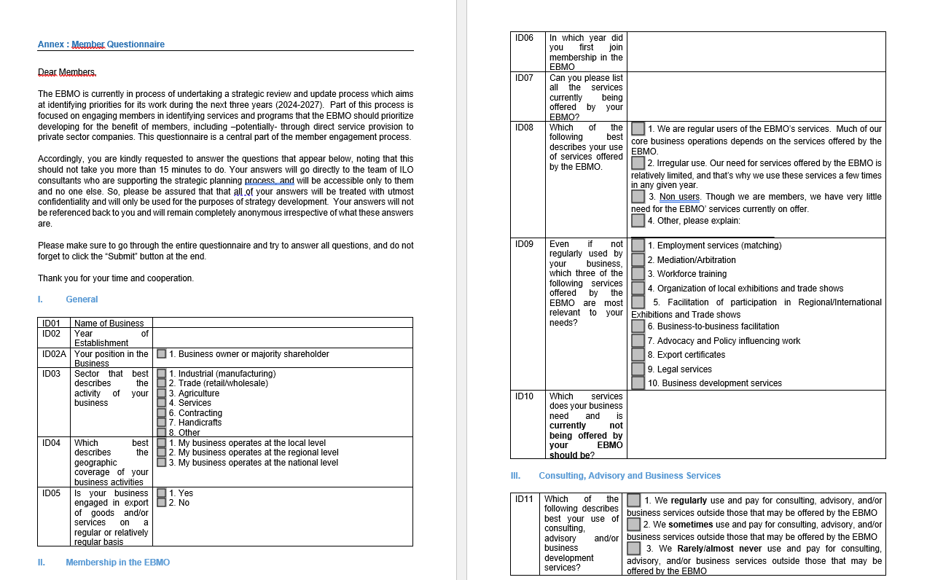

Slide 20
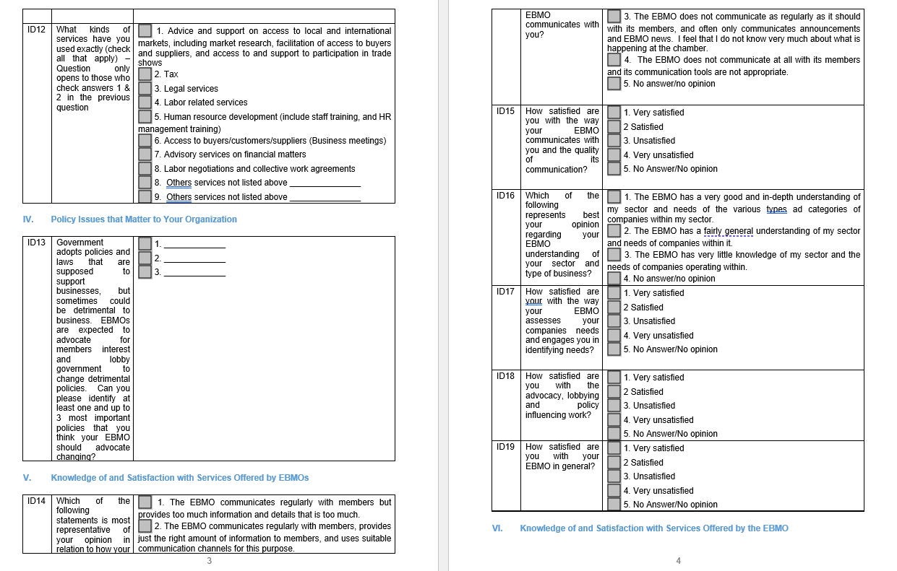

Slide 21
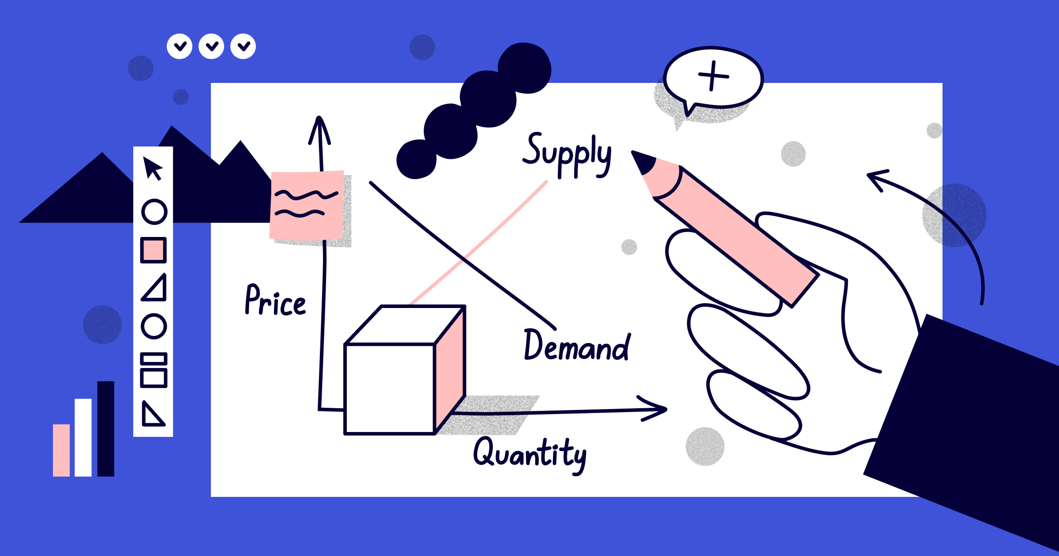
2. Sounding out the market: demand and supply analysis
Question: How Can We Be Relevant and Successful with Our Services Offer via Demand Orientation?
For whom? Our existing members or potential target members?
Present needs or future anticipated needs?
How to define these needs accurately? Methods.
Your Comments and Present Experiences: 10 minutes plenary

Slide 22
LET’S EXPLORE THE THEMES OF THIS COURSE
1. The role of EBMOs: main accent on policies or services?
2. Sounding out the market: demand and supply analysis
3. Key ingredients for successful services
4. Which services? Innovative and emerging services: What and How?
5. Cost, Price, and Service Sustainability
6. Legal mandate, delivery options and the marketing mix
7. Monitoring & Evaluation

Slide 23
To start with…
In your experience which are the key ingredients to set up successful services?

Slide 24
Key ingredients
1) Importance of Measuring Data such as:
Revenue generated – gross or net?
Member satisfaction? How to measure? Net Promoter Score?
Member usage?
Frequency of member usage?
Number of members increase.
Specific criteria may differ per EBMO/country, but these are commonly used.

Slide 25
Key ingredients
2) EBMO branding and reputation
Quality
Trustworthiness and Confidentiality
Fair price (not necessarily the cheapest)
Long-term solutions
Client orientation

Slide 26
Key ingredients
3) Internal capacity and practices
Staff competency
Staff attitudes
Technology tools such as internet access for members, assistants, Q&A platforms, blended learning
Ecosystems of collaboration
Networking facilities
But no one size fits all, and no single factor is a magic solution.

Slide 27
Key ingredients
4) General Management – running services as a "Business":
Sound financial management
Marketing and promotion
Innovation
Motivating HR policies for service staff
Technology sound approach

Slide 28
LET’S EXPLORE THE THEMES OF THIS COURSE
1. The role of EBMOs: main accent on policies or services?
2. Sounding out the market: demand and supply analysis
3. Key ingredients for successful services
4. Which services? Innovative and emerging services: What and How?
5. Cost, Price, and Service Sustainability
6. Legal mandate, delivery options and the marketing mix
7. Monitoring & Evaluation

Slide 29
To start with…
Any example of unsuccessful service? Why did the EBMO in that specific circumstances fail?
On the contrary, can you describe a particularly innovative service which was recently established by EBMOs?
Many EBMOs have been slowly moving out from providing services in labour areas only, to cover a broader spectrum of business areas. Which are new or emerging areas where EBMOs might need to invest in / build their own capacity in order to meet members’ needs and expectations?
And now going back to traditional labor related and HR services, can you provide a comprehensive list (and description) of services provided by EBMOs?

Slide 30
Current Challenges and Innovations
Current Challenges:
Lack of innovation; generic management; inadequate competitor analysis.
Market context, technology, and subsidy changes not taken into account.
Neglect of staff leading to loss of valuable personnel.
Limited scope of EBMO services: No competition allowed with members.
Services lack sufficient quality.
Issues with marketing strategies: lack of focus on niches and spreading efforts too thinly.
Competitor analysis is inadequate and not sufficiently broad.
Innovative and Emerging Services:
Training: Efforts to be more user-friendly in content, offering, location, timing, and format.
Labour Law: More integrated approach with services beyond advice.
HR: More emphasis on new trends, e.g., Female Future (East Africa).
Entrepreneurship: Key service for SMEs.
Generic management: Successful project management and subsidies.
Generic management (HR, finance, sales) professional.
Success Stories in Asia (SL, SIN, MAL, NZ) and some in AFR (UG, TA, CAM), and LA (often building upon CoC past).

Slide 31
Which services? Innovative and emerging services: What and How?
DEBATE 1: In Your Country: Which Innovations and New Services?
Describe and exchange your views and experiences.
If no innovation, why do you think that is?
What, in your opinion, is obsolete in your EBMO services?
Each group has a maximum of 10 minutes for discussion and presentation.

Slide 32
Trends in Innovative and Emerging Services
Main drivers of new trends:
New technology
Customer expectations
Market dynamics
Shift in worker characteristics
Main Trends in Services:
Digital transformation (AI, automation, remote accessibility)
Personalization and customization (data-driven insights)
Remote service delivery (Teams, video, augmented reality)
Sustainability and environmental responsibility
Collaborative services ecosystems
Specialisation
Proactive maintenance
Notes:
Basis, McKinsey, Bain, Deloitte, and Others

Slide 33
Specific Service Trends: HR Services
Payroll and taxes
Regulatory compliance
Benefits administration (and data)
Recruitment and hiring
Training and development
Employee relations and industrial relations (IR)
Workplace policy
Career development
Data management
Occupational safety and health (OSH)
Wellness

Slide 34
Trends in Labour Law Services
Information readymade-personalised – anytime /anywhere-Q&A
Compliance support / certification
Combined services : law, HR, well being, on site
Non jurisdiction settlements: private arbitration
Importance non discrimination and ESG

Slide 35
Trends in Training and Development Services
LMS: Learning Management Systems
AI: Artificial Intelligence
AR: Augmented Reality
User-generated content
Learning on demand; personalized; self-directed
Importance of inclusion, diversity
Gamification

Slide 36
Trends in other services areas
Examples:
OSH
Events
Employee relations
Payroll admin
Industrial relations with trade unions; dispute settlement
…………………

Slide 37
Innovation Insights
Current Innovation Landscape:
Limited spectacular innovation observed.
Some process innovations like website enhancements and member portals.
Challenges in content innovation due to:
Limited understanding of member needs.
Insufficient investment in CRM for member profiling.
Rising competition from private and public agencies.
Emphasis on advocacy roles within EBMOs.

Slide 38
Emerging Service Development
How Do New Services Emerge?
Identification of new themes through needs analysis.
Integration of new technologies, especially in training.
Deepening and expanding existing service offerings.

Slide 39
WHICH NEW SERVICE for your EBMO?
Imagine you are in front of the board and must convincingly pitch your new service, focusing on:
Your Objectives with the Service: Revenue, membership growth, visibility, etc.
Your target group
Your Constraints: Commercial competency, staff competency, member preferences, competition from other EBMOs or companies, alignment with core business and vision of EBMO, relations with sectors/regions.
Get ready to present the pitch you developed during last week's exercise!

Slide 40
LET’S EXPLORE THE THEMES OF THIS COURSE
1. The role of EBMOs: main accent on policies or services?
2. Sounding out the market: demand and supply analysis
3. Key ingredients for successful services
4. Which services? Innovative and emerging services: What and How?
5. Cost, Price, and Service Sustainability
6. Legal mandate, delivery options and the marketing mix
7. Monitoring & Evaluation

Slide 41
Service Sustainability
Delivering services has a cost for the Organizations. How to generate income to cover such costs or eventually generating a surplus? Several options are available:
Members pay:
a) Per service
b) Services included in membership fees
Others pay:
a) Government subsidies or grants
b) Projects

Slide 42
Model 1: Members pay
Model 1a: Members receive limited services for free (general basic ones such as information) and pay for the others.
Model 1b: All services are included in the membership fee.
Advantages and Disadvantages?
Notes:
Practice:
Model 1a) is used in the English-speaking world (Africa-Asia).
Model 1b) is used in French-speaking Africa and Latin America.

Slide 43
Model 2: Others pay
Model 2a: Services are paid by grants given by the government or donors (competitive bidding or not); for members, services are free.
Model 2b: Services are paid by projects funded by the government or donors with specific goals, and services within the framework of that project are free for members.
Advantages: No income pressure, easy to plan.
Disadvantages: Dependency, mission creep, dominance by others' agendas, limited market pressure.
Notes:
Practice:
Model 2a) in the English-speaking world (Asia).
Model 2b) in Africa and Latin America.

Slide 44
Pricing strategies
Competitive price: most EOs are used to fix the price equal to competitors or even lower, thinking it is the only driver for clients’ choice.
Cost recovery
Price should cover production cost and fixed cost. The organization calculates the cost of producing the product and set the price accordingly: selling price=production cost.
Cost-plus pricing
The organization calculates the cost of producing the product and adds on a percentage (profit) to that price to give the selling price.
Value Based pricing
Pricing a service based on the perceived value of the service and not keeping into consideration any other factor. This is usually the most profitable form of pricing, if an employers’ organization can achieve it. must be considered.
Premium pricing
Premium pricing is connected to Value Based Pricing and it is the practice of keeping the price of a service artificially high in order to encourage favorable perceptions among buyers, based solely on the price. organization towards members.
“Flat rate” pricing
For some specific services like representation of members in dispute settlement mechanism, some organizations offer a sort of “flat rate”, instead of charging on daily or hourly basis.

Slide 45
Revenue-cost-surplus?
Is service delivery "good" business and surplus-oriented? Probably yes, but data is lacking and not extremely conclusive. Most EBMOs lack a separate cost overview:
External costs are registered (consultants, infrastructure, ...).
Internal costs are not accounted for (staff, management time).
Additionally, there are sometimes fiscal surprises. As a result, there is no real cost-benefit evaluation. Gross revenue/surplus (around 50%) is mistaken for net surplus.

Slide 46
SME’s and payment of services
Issue: SME Paradox - Most Need; No Funds; No Access
Solutions in Most EBMOs:
Attempt to secure projects for SMEs.
Diminish prices via cross-financing (from project or general funds).
Encourage savings for future investment.

Slide 47
Sustainability of projects and services set up
What to do when the project ends, how to get ready for that?
Create reserves.
Inform users, staff, and EBMO.
Phasing out is important.
Create "hereditary projects" with more sustainability.

Slide 48
Which model for your service?

Slide 49
LET’S EXPLORE THE THEMES OF THIS COURSE
1. The role of EBMOs: main accent on policies or services?
2. Sounding out the market: demand and supply analysis
3. Key ingredients for successful services
4. Which services? Innovative and emerging services: What and How?
5. Cost, Price, and Service Sustainability
6. Legal mandate, marketing mix and delivery options
7. Monitoring & Evaluation

Slide 50
Legal mandate
Do you have the mandate and right to sell services?
Any legal and fiscal consequences?

Slide 51
Marketing mix
Marketing mix strategy is a set of actions in some interrelated areas that can influence the consumer/member decision to purchase a service
The marketing mix decisions regard 4 “Ps”: product/service, promotion, place, price
There are 4 main requirements your organization should satisfy so to obtain an effective marketing mix strategy:
-meet the needs;
-create competitive advantages;
-Have the needed resources;
-be coordinated
Notes:
Meet the needs: members’ satisfaction means members’ retention. Analysing the needs and meeting them proves an organization is market and marketing oriented.
Create competitive advantages: the advantages can be defined by the organizations’ market positioning (what) and its core resources and skills (how). Using these two sources of competitive advantages an EO should be able to obtain better results in its business environment.
Have the resources: the quality and the amount of the resources at organization’s disposal represent limitations to marketing mix actions. Some of them are: financial resources, human resources, organization’s structure, core skills and knowledge, etc.
Be coordinated: Besides defining single elements of marketing mix, it is very important to define relations among them and to find the right combination for each service. Wrong choice of single elements or elimination of one of them may hinder success of the service on the market.

Slide 52
Notes:
Product - The product aspects of marketing deal with the specifications of the actual goods or services and how it relates to the end users needs and wants.
Place - This refers to how the product gets to the customer. This P also refers to the channel by which a product or service is sold, which geographic region or industry, to which segment (young people, families etc) also referring to how the environment which the product is sold in can affect sales.
Pricing – This refers to the process of setting a price for a product, including discounts. This price includes what is exchanged for the product which can be money, time, energy or attention.
Promotion – This includes advertising, sales, promotion, publicity and personal selling. The branding of the product or service is also included in this section.

Slide 53
Promotion
In order to achieve these goals there are several promotion instruments with two different purposes
Promotional
Mix
Advertising &
Internet
Public
Relations
Sponsoring
Personal
Sales
Sales
Promotion
Direct
Mail
RAISING AWARENESS
SELL
Notes:
In order to achieve these goals, there are a number of instruments used especially for promotional purposes.

Slide 54
Delivery Options
DIRECT PROVIDER
Direct distribution
EO delivers service with its own staff
EO Level of involvement
PARTNERSHIP
EO establishes an alliance for delivery of services
OUTSOURCING
EO contracts a firm to deliver the service on his behalf
Indirect distribution
REFERRAL
EO connects its members with existing service providers

Slide 55
LET’S EXPLORE THE THEMES OF THIS COURSE
1. The role of EBMOs: main accent on policies or services?
2. Sounding out the market: demand and supply analysis
3. Key ingredients for successful services
4. Which services? Innovative and emerging services: What and How?
5. Cost, Price, and Service Sustainability
6. Legal mandate, marketing mix and delivery options
7. Monitoring & Evaluation

Slide 56
Evaluation & Monitoring
M&E tools

Slide 57
Evaluation and Monitoring of a New Service Developed in an Employer's Organization
Implementing a new service within an employer's organization requires thorough evaluation and monitoring to ensure its success and sustainability. This process involves both financial and organizational metrics to provide a comprehensive understanding of the service’s performance and impact.

Slide 58
Financial Evaluation
Financial evaluation focuses on understanding the financial health and viability of the service. Key metrics to consider include:

Slide 59
1. Total Income of Services/Total Income:
This ratio measures the contribution of the new service to the overall income of the organization. A higher ratio indicates greater financial significance of the service.

Slide 60
2. Income per Service/Total Income of Services:
This metric breaks down the income generated by each service as a proportion of the total income from all services, helping to identify which services are the most profitable.

Slide 61
3. Total Costs of Services/Total Income of Services:
This ratio assesses the cost efficiency of the services. Lower ratios indicate higher efficiency and better financial performance.

Slide 62
4. Costs per Service/Total Costs of Services:
By examining the cost incurred for each service in relation to the total costs, the organization can identify cost-heavy services that may need optimization.

Slide 63
5. Total Income – Total Costs = Surplus:
Calculating the surplus provides a direct measure of profitability for the service.

Slide 64
6. Surplus per Service/Total Surplus of Services:
This metric evaluates the contribution of each service to the overall surplus, highlighting the most and least profitable services.

Slide 65
7. Total Surplus of Services/Total Costs of Services:
This ratio indicates the return on investment (ROI) for the services. A higher ratio suggests better financial health.

Slide 66
Organizational Monitoring
Organizational monitoring involves evaluating the impact of the service on the organization’s operations and its members. Key metrics include:

Slide 67
1. Number of Users:
Tracking the total number of users helps in understanding the reach and adoption of the service.
Number of Users/Total Number of Members:
This ratio provides insight into the service's penetration among the organization’s members.

Slide 68
2. Evaluate the Satisfaction of the Service Through Qualitative Surveys:
Conducting surveys allows the organization to gather feedback on user satisfaction, uncovering areas for improvement and assessing overall service quality.

Slide 69
3. Frequency/Repetition of Purchases per User:
Monitoring how often users purchase the service can indicate its perceived value and user dependency.

Slide 70
4. Users per Service:
Identifying the number of users for each service helps in understanding the popularity and relevance of each offering.

Slide 71
5. Percentage of Users as Members and Non-Members:
This metric shows the breakdown of service users into members and non-members, helping to gauge the service’s appeal beyond the membership base.

Slide 72
6. Percentage of Users Which Has Become Members (if the EO Provides Service to Non-Members):
Tracking conversion rates from non-members to members due to the service can highlight its effectiveness in attracting new members.

Slide 73
Implementation and Analysis
Effective evaluation and monitoring involve systematic data collection, thorough analysis, and regular reporting and review to ensure the new service meets its goals.

Slide 74
1. Data Collection
Accurate and regular recording of financial transactions and user data is crucial. Develop comprehensive surveys with both quantitative and qualitative questions to capture user satisfaction, needs, and preferences.
Employ tools such as:
Google Forms/Qualtrics: To create surveys and gather user feedback effectively.
CRM: A CRM system centralizes customer data, enabling businesses to track interactions, segment users based on behavior and demographics, and personalize communication. It aids in monitoring sales, analyzing user engagement, and improving customer service by providing detailed insights into customer needs and preferences.

Slide 75
2. Data Analysis
Use financial ratios to assess cost efficiency, profitability, and overall financial health. Analyze usage patterns, frequency, and repetition to understand user engagement, segmenting users based on behavior and demographics for targeted improvements.
Employ tools such as:
CRM: A CRM (Customer Relationship Management) system centralizes customer data, enabling efficient data analysis and collection. It tracks interactions, segments users, and provides insights into customer behavior and financial metrics. This helps improve customer engagement, optimize resource allocation, and support targeted marketing efforts.

Slide 76
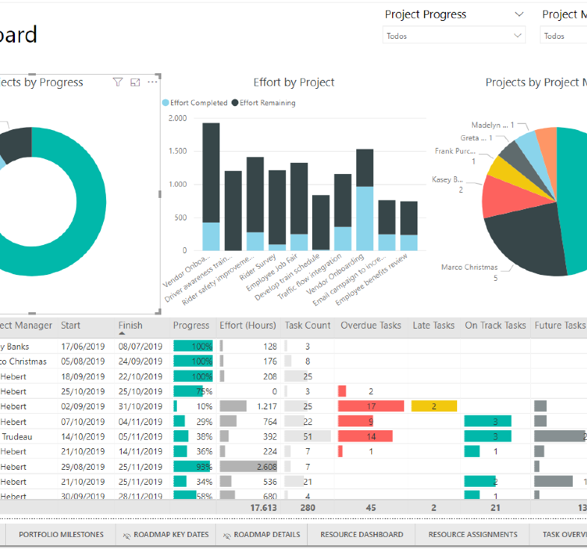
3. Reporting and Review
Generate monthly and quarterly reports to track financial and organizational metrics, utilizing visual aids for clarity. Conduct regular review meetings with stakeholders to discuss findings, implement adjustments, and refine the service. Continuously update the service based on user feedback and performance metrics, fostering innovation and flexibility to adapt to changing needs.
Employ tools such as:
Microsoft Power BI: Creates interactive dashboards for tracking financial and organizational metrics.

