Slide 1
INNOVATIVE STRATEGIES FOR MEMBERSHIP DEVELOPMENT

Slide 3
Why is it crucial?
Revenue – resources
Representativeness - influence

Slide 4
Professional membership development strategy
Members are the most important asset for any EBMOs
Most EBMOs do not have a formal membership strategy
Why? That’s illogic!!!

Slide 5
Strong the membership….
Further growth and influence
More resources
Increasing membership
High representativeness
High quality services
More resources
High membership

Slide 6
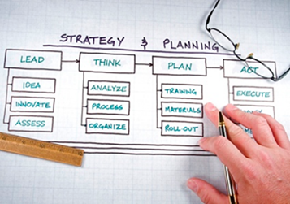
Reactions of BMOs
Reactions of EBMOs
1) Instinctive one (not planned, improvising)
Lots of efforts, but not efficient and effective (costly) and not coherent (NO strategy)
2) A more professional one
(planned, structured)
«We need more communication!, a membership pack!, launch new services!»...
Membership is a complex issue, which needs planning, holistic approach, a comprehensive strategy and dedicated support tools

Slide 7
Who are EBMOs members?
Clients
Service users
Funders
Owners
Decision-Makers
Debtors
A very peculiar mix: EBMOs are a very strange, probably unique business
Notes:
voluntarios

Slide 8
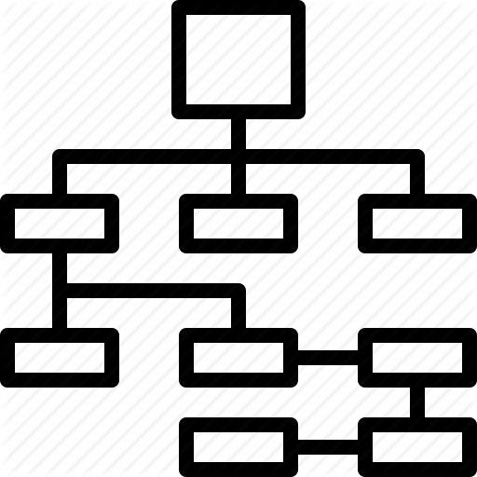
Key Membership concepts
Who can be a member
Members which pay and members which do not pay
Direct members vs. Indirect members
Membership dues
Compulsory vs free membership
Notes:
DISCUSSION: full vs associate members ( example . Those with light access to services or members via internet only …

Slide 9
Who can be a member?
Employers’ Organizations (sectoral or lower level)
Private companies
State owned or para statal companies?
Informal enteprises?
NGOs? Embassies?

Slide 10
The concept of indirect membership
Employers Federation
Type of members
Company members: 3,500
Association members: 8 sectoral association and 5 provincial organizations
The 8 sectoral organizations and 5 provincial organizations have company members: in total 10,000 company members.
These 10,000 companies are indirect members of the Employers Federation
Total number of members in the Federation: direct + indirect 13,500 members

Slide 11
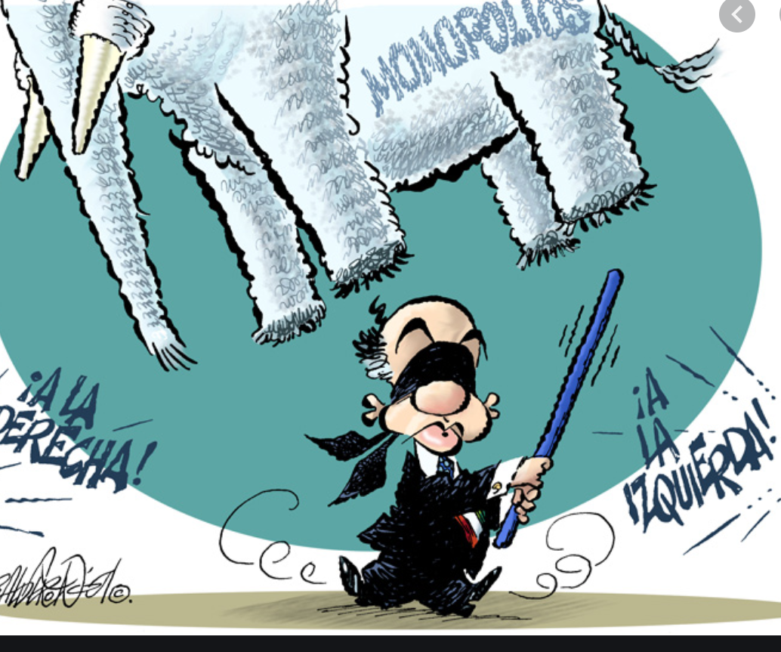
Voluntary or compulsory affiliation?

Slide 12
Membership income (46%)
For 90% of all EBMOs, membership income constitutes the primary and principal avenue for enhancing financial sustainability, accounting for an average of 40-50%, often reaching around 70% of their annual income.
Notes:
A gradual increase in membership income is evident, with no significant surges.
Persistent ambiguity surrounds the differentiation between direct and indirect membership, along with associated issues related to roles, contributions, entitlements, and potential governance challenges within associations.
Larger countries often adopt territorial approaches, establishing regional offices; however, reports on the significant success of these strategies are limited. While organizations maintaining regional strategies generally continue with them, broader expansion appears relatively rare.
• Organizations are exploring new membership markets, including SMEs, the informal economy, and specific groups such as women and young entrepreneurs. This exploration sometimes involves the introduction of specially discounted membership formulas. Although relatively novel, assessing the long-term sustainability and impact on both membership and income remains challenging at this stage.
• Despite increased attention and acknowledgment of the decline, a notable number of organizations continue to grapple with challenges such as overdue payments or non-paying members, reaching levels as high as 30-40%.
• The establishment of dedicated departments or functions for membership recruitment and retention reflects heightened awareness and specific attention to membership matters.
• Most EBMOs deploy a variety of activities, including improved communication, clear value propositions, and segmentation, showcasing a determination to succeed. There is slow but steady progress in increasing membership numbers.
• A widespread recognition of the importance of using CRM systems for managing membership income, is noted.
•income diversification was achieved by establishing policy discussion "venues/clubs." Larger companies, previously excluded from direct membership, now participate through a unique membership status, reducing reliance on funding from regional associations.
•Undergoing a significant transformation in fee payment structure, this organization shifted to a modular and voluntary membership fee system. Companies can choose membership categories based on specific services menu they want to acces to, reflecting a trend where EBMOs offer a versatile menu of benefits.
•
•

Slide 13
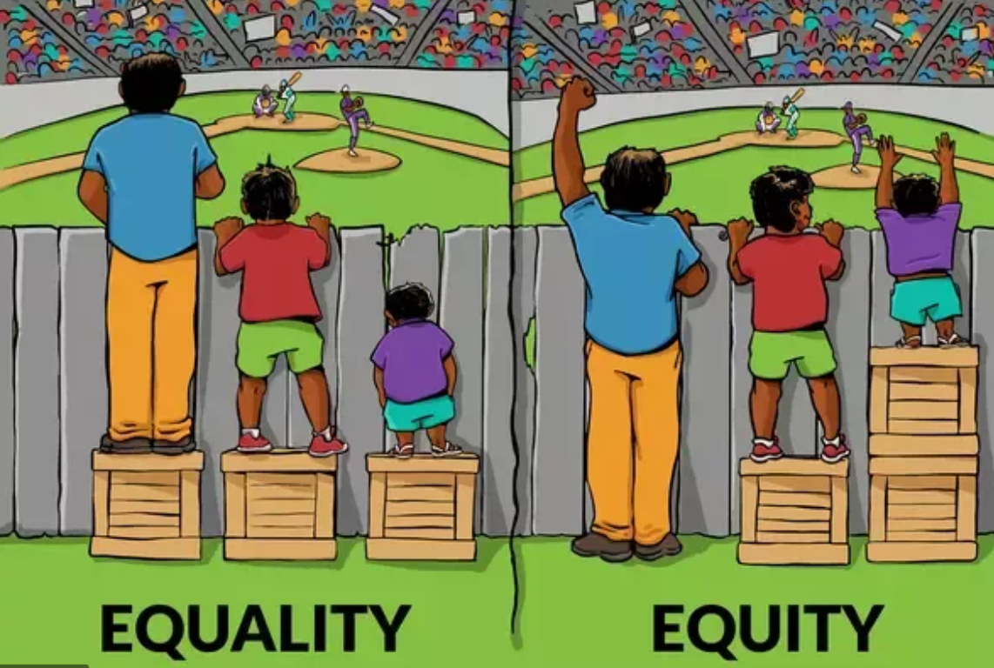
Membership fees
Flat rate
Tier system

Slide 14
Tier system – types:
Number of employees
Wage bill
Turnover or financial assets
More complex formulas
Contribution-based tier system
If you pay more you get access to
More services and/or have a
stronger voice

Slide 15
Main objectives of a membership strategy
Revenue – resources
Representativeness - influence

Slide 16
Overarching goal
Increase the revenue and the representativeness of organization
Any different opinion?

Slide 17
How do we measure the representativeness? – Choosing the right indicators – Baseline and KPIs
Representativeness
N° of paying members (direct and indirect)
N° of employees employed by your members
Value added generated by your members
Taxes paid by your members
Or as a ratio
N° of paying members (direct and indirect) / number of registered companies in the country
N° of employees employed by your members / formal employment private sector
Value added generated by your members / GDP
Example - baseline
At the end of 2024, the EBMO represents 2000 companies providing employment to 2,000,000 employees and representing 20% of employment in the formal private sector and 15% of GDP.

Slide 18
How do we measure the income? Choosing the right indicators – Baseline and KPI
Income
Revenue generated by membership fees
Revenue generated by paying services (if any) or average spending per member on paying services
Example baseline
At the end of 2024 the revenue generated by membership fees is equal to 350,000 USD and this represents 50% of the total income of the EBMO. Average members spending on services is 80 USD.

Slide 19
The skeleton of a 3-year membership strategy
Increase the revenue and the representativeness of organization
Overarching goal
HOW?
Recruit new members
Retain more members
Have more engaged members
Outcome 1
Outcome 2
Outcome 3
Any additional idea?

Slide 20
The skeleton of a 3-year membership strategy
Overarching goal
Outcome 1
Outcome 2
Outcome 3
Output 1.1
Output 1.2
Output 2.1
Output 2.2
Output 3.1
Output 3.2
Activity 1.1.1
Activity 1.1.2
Activity 1.2.1
Activity 2.1.1
Activity 2.2.1
Activity 2.2.2
Activity 3.1.1
Activity 3.2.1

Slide 22
Example
Overarching goal
Baseline
1000 members, no data on representation of the private sector employment, 30% of the total income derived from membership fees
Increase the representativeness of the organization
Targets
Have 1500 members and represent 20% of the private sector employment, 40% of the total income derived from membership fees
Milestone end year 1 Have 1200 members, no data on employment and 34% of the total income derived from membership fees yet
Milestone end year 2 Have 1400 members, represent 18% of the private sector employment and 38% of the total income derived from membership fees

Slide 23
The skeleton of a 3-year membership strategy
Increase the revenue and the representativeness of organization
Overarching goal
HOW?
Recruit new members
Retain more members
Have more engaged members
Outcome 1
Outcome 2
Outcome 3

Slide 24
The skeleton of a 3-year membership strategy – we need to have a baseline, fix milestones and final targets
Overarching goal
Increase the representativeness of the organization
Baseline
1000 members, no data on representation of the private sector employment, 30% of the total income derived from membership fees, average service spending is 200 USD
Final Targets
Have 1500 members and represent 20% of the private sector employment, 40% of the total income is derived from membership fees and average service spending is 400 USD
Milestones end year 1 Have 1200 members, no data on employment and 34% of the total income derived from membership fees yet
Milestones end year 2 Have 1400 members, represent 18% of the private sector employment and 38% of the total income derived from membership fees

Slide 25
The skeleton of a 3-year membership strategy
Increase the representativeness of the organization
Overarching goal
Recruit new members
Retain more members
Have more engaged members
Outcome 1
Outcome 2
Outcome 3
Output 1.1
Output 1.2
Output 2.1
Output 2.2
Output 3.1
Output 3.2
Activity 1.1.1
Activity 1.1.2
Activity 1.2.1
Activity 2.1.1
Activity 2.2.1
Activity 2.2.2
Activity 3.1.1
Activity 3.2.1

Slide 26
Recruit new members
Indicators
Number of newly recruited members
Average number of newly recruited members in the last 3 years
Recruitment rate
N° of new members in year t / Total members in year t-1
Total Income fees paid by newly recruited members

Slide 27
Retain more members
Indicators
Retention rate
N° members which renew in year t /
Total n. of members at the end of year t-1
Retention rate by specific groups
Retention rate of large companies
Retention rate of members within the first three years of membership
Etc.

Slide 28
Engage more members
Indicators
Average spending on paying services
% members which use at least one service per year
Number of members which attend the annual members assembly
Other ideas?

Slide 29
More radical changes
Changes in the membership fees (change amount – change fees criteria)
Changing statutes to allow membership of groups which were not allowed to join the EBMO

Slide 30
The skeleton of a 3-year membership strategy
Increase the representativeness of the organization
Overarching goal
Recruit new members
Retain more members
Have more engaged members
Outcome 1
Outcome 2
Outcome 3
Output 1.1
Output 1.2
Output 2.1
Output 2.2
Output 3.1
Output 3.2
Activity 1.1.1
Activity 1.1.2
Activity 1.2.1
Activity 2.1.1
Activity 2.2.1
Activity 2.2.2
Activity 3.1.1
Activity 3.2.1

Slide 31
We need to have a baseline, fix milestones and final targets at outcome level as well
Baseline: 50 new members recruited annually in previous years
Baseline: 30% of the members use at least 2 services. 40% participate in the AGM
Baseline: 50% of the members pay subscription fees
Retain more members
Recruit new members
Have more engaged members
3 year target: 85% of the members pay subscription fees
3 year target: 60% of the members use at least 2 services. 70% participate in the AGM
3-year target: 600 new members
Milestone end year 1: 60% of the members pay subscription fees
Milestone end year 1: 200 new members
Milestone end year 1: 40% of the members use at least 2 services. 50% participate in the AGM
Milestone end year 2: 70% of the members pay subscription fees
Milestone end year 2: 300 new members
Milestone end year 1: 50% of the members use at least 2 services. 60% participate in the AGM

Slide 32
We need to have a baseline, fix milestones and final targets at outcome level as well
Baseline: 20 new members recruited in year t-3
Baseline: 30% of the members use at least 2 services. 40% participate in the AGM
Baseline: 50% of the members pay subscription fees
Recruit new members
Retain more members
Have more engaged members
3-year target: 85% of the members pay subscription fees
3-year target: 600 new members
3 year target: 60% of the members use at least 2 services. 70% participate in the AGM
Milestone end year 1: 60% of the members pay subscription fees
Milestone end year 1: 200 new members
Milestone end year 1: 40% of the members use at least 2 services. 50% participate in the AGM
Milestone end year 2: 70% of the members pay subscription fees
Milestone end year 2: 300 new members
Milestone end year 1: 50% of the members use at least 2 services. 60% participate in the AGM

Slide 33
We need to have a baseline, fix milestones and final targets at outcome level as well
Baseline: 30% of the members use at least 2 services. 40% participate in the AGM
Baseline: 50% of the members pay subscription fees
Baseline: 20 new members recruited in year t-3
Have more engaged members
Retain more members
Recruit new members
3 year target: 60% of the members use at least 2 services. 70% participate in the AGM. Average service spending is 400 USD per year
3 year target: 85% of the members pay subscription fees
3 year target: 600 new members
Milestone end year 1: 60% of the members pay subscription fees
Milestone end year 1: 40% of the members use at least 2 services. 50% participate in the AGM Average service spending is 200 USD per year
Milestone end year 1: 200 new members
Milestone end year 2: 70% of the members pay subscription fees
Milestone end year 2: 50% of the members use at least 2 services. 60% participate in the AGM
Average service spending is 250 USD per year
Milestone end year 2: 300 new members

Slide 34
Each activity will determine certain outputs that would contribute to the achievement of certain outcome(s) – the outcomes will support the achievement of the final goal

Slide 35
Example
Activity 1.1.1 (year 1)
Recruitment campaign in district X through the organization of an information event for business owners
Activity 1.1.2: Radio advertisement in the district X
The activities 1.1.1. and 1.1.2 bring as output (1.1) the recruitment of 25 new members
Activity 3.1.1 (year 1)
Social media campaign explaining the role of Annual General Meeting and Board members in defining the EBMO policy priority
Expected Output: increased participation by 5% in the number of members attending AGM and Board meetings
Activity 3.2.1 (year 1)
Awareness campaign on the service package of EBMOs – short videos by ambassadors illustrating the benefits of taking ceertain services
Expected output: increased awareness on the service offer of EBMOs
ETC.

